Slide 1


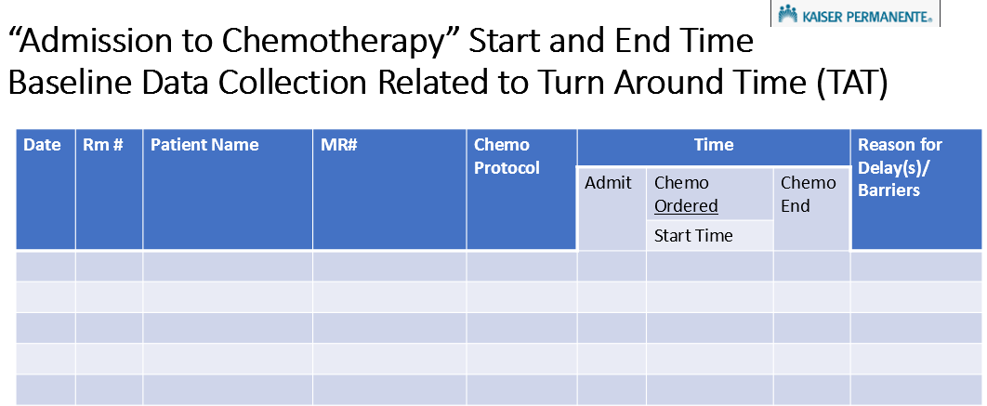
RN 4 Project-Chemotherapy Administration Delays in the Acute Care Setting for Hematologic and Solid Tumor Patients Phase 1: Benchmarking Barriers
Deborah Bolton MN, RN, CNS-FNP,AOCNS, AOCNP, Kaiser Permanente, Oakland, Ca., Peter Sumbillo, BSN, RN, Kaiser Permanente, Oakland Ca.; Mary Ann Gamido, BSN, RN, Kaiser Permanent, Oakland, Ca.
Institution logo may be placed here or on other side
Interventions
The below tracking tool was developed by the RN project coordinator who educated staff on three shifts to complete.
Background and Significance
In 2019, elective patients were admitted to the 24-bed Acute Care mixed Med-Surg Oncology unit at 0830 on the day of chemotherapy administration. The protocol wasn’t initiated for at least two shifts. Administration delays in the acute care setting impacted the length of stay, chemotherapy administration staffing, and patient and physician satisfaction. Literature reflected the primary delays occurring in the ambulatory settings due to physician orders and pharmacy preparation. And this was re-iterated in acute care literature with limited focus on the variety of protocols ordered on the inpatient setting. The initial focus was High Dose Methotrexate Administration and the Leadership Team requested expansion to other protocols.
Drug Protocols: MD-MTR +/- Ibrutinib, Carbo Desensitization, Decitabine+Venetoclax, ICE +R, R-HyperCVAD, DA-EPOCH, R-CHOP, MAP, Cytarabine, HiDAC, R-MAXI, CHOP, Carbo-VP16, 7+3, GCLAC, EA, Blincyto, Azacytidine+ venetoclax, CALGN-1043, ATG, Vyxeos
Categories of Chemotherapy Administration (4): Elective admissions, interhospital and intrahospital transfers, and off unit Chemo administered by Chemotherapy RN staff.
Timeframes: Range: 8 hours-33.5 hours; Wait Time Range: 2.3 hours-9.5 hours; wait time average: 5.38 hours.
Themes (6): Physicians, Pharmacy, Nursing Leadership, Patient, RN, EVS.
Discussion
The findings highlight the complexity of chemotherapy administration in the acute care setting and the multifaceted nature of the barriers contributing to delays.
Evaluation
Barriers (23): Orders not released, waiting MD, VAD placement/radiology report, urine output, premedication, diagnostic tests, patient education, room not ready, hydration/bicarb-pH, transfusions, unstable, out or ratio/Chemo RN/Verifier, Pharmacy chemo delivery, lab processes, pharmacy staffing, patient not ready, equipment missing/malfunctioning, short staffing, locating non-hem/Onc MD, admission or transfer processes, shift change, change of chemotherapy timing.
Purpose: Qualitative benchmarking to identify the chemotherapy protocols, admission to chemotherapy orders to start and end times, and delays/barriers.
Acknowledgments:
Kaiser Oakland Leukemia-lymphoma leadership team

