Slide 1


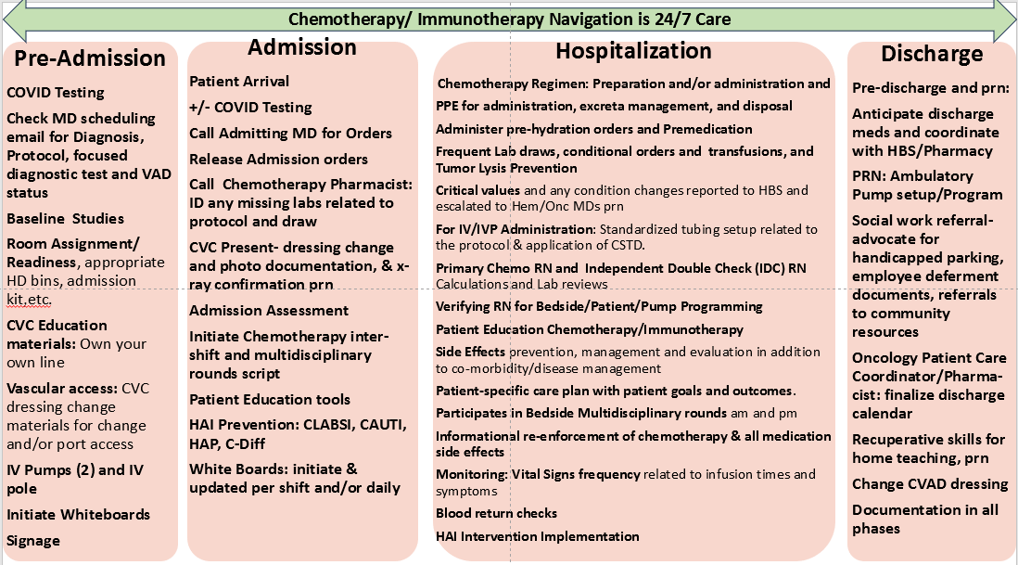
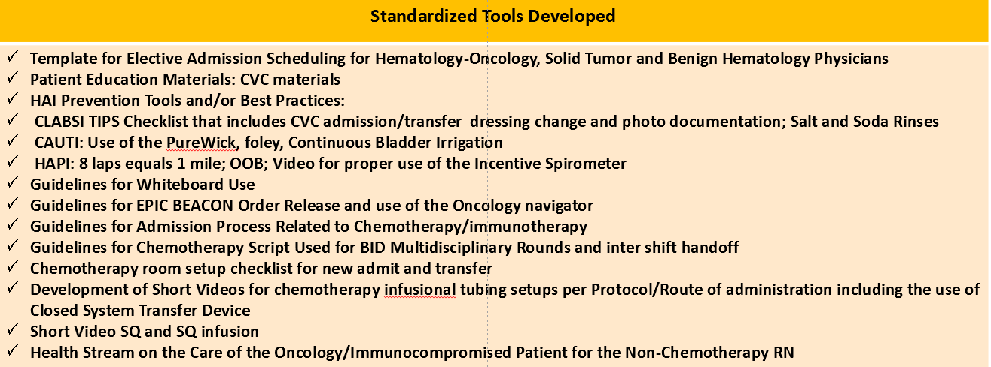
Chemotherapy Navigation From Admission to Discharge, by Unit-Based RNs
in a Community Hospital Acute Care Setting: A RN IV and III Project Deborah L. Bolton MN, RN, AOCNS-AOCNP; Peter Sumbillo BSN, RNIV; Mary Ann Gamido, BSN, RNIII
Kaiser Permanente Oakland CA
Institution logo may be placed here or on other side
Chemotherapy / Immunotherapy Navigation is 24/7 Care
Background and Significance
Patient navigation has gained prominence, with specialized roles, competencies, certifications, and job descriptions for navigators. Initially, navigators were in ambulatory settings.
The concept of population-specific navigators has expanded to include acute care settings.
This abstract addresses the unique challenge of inpatient chemotherapy navigation, involving close collaboration with various healthcare professionals, including medical teams, pharmacists, dietitians, physical therapists, Vascular Access Practitioners, Recuperative Skills, Clinical nurse specialists, Oncology case managers, and Oncology nurse practitioners.
Evaluation
The program was integrated into new hire onboarding and is subject to annual reviews and updates to ensure its continued relevance and effectiveness.​
Purpose
Discussion
Define and standardize inpatient chemotherapy navigation elements, processes and the role of RNs on a 24/7 basis. ​
Collaborate with a gap analysis and the development of transitional tools. ​
Illustrate patient navigation patients through the complex process of chemotherapy administration, monitoring, and symptom management, from preadmission, admission, hospitalization, and discharge phases.​
This project showcases the innovative and collaborative efforts of acute care unit-based Oncology RNs in navigating patients through the complexities of chemotherapy administration.
It underscores the importance of consistent staffing and leadership to ensure the continued success of patient care outcomes.
Interventions
Development of tools for each element of the navigation process.
Staff education with implementation of each tool.
Tool incorporation into patient navigation and education.
Incorporation into New Hire Onboarding and Annual Oncology Education and Skills.
Acknowledgements
Kaiser Permanente Nursing Leadership

