Slide 1


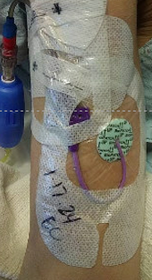
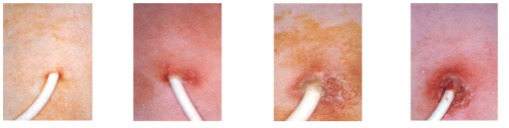
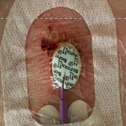
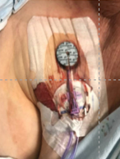
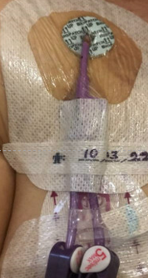
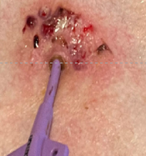
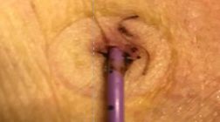
Adopting Photo Documentation to the CLABSI Prevention Bundle: A Novel Concept in Benchmarking
Deborah Bolton, MN, RN, CNS-FNP, AOCNS, AOCNP Kaiser Permanent Oakland Ca.
Rollout: Staff education- Huddles, Oncology Annual Skills, and Daily Multidisciplinary Rounds
Evaluation
70% reduction in CLABSI from 2019-2022
3rd Step added with photo-documentation following re-dressing
Un
Background and Significance
Central Line-Associated Bloodstream Infections (CLABSIs) are a significant concern in healthcare settings leading to increased morbidity, mortality, and healthcare costs. In 2016, the community based acute care 24 bed oncology medical-surgical unit, implemented CLABSI prevention “best practices”. Despite the implementation of best practices and preventive measures, challenges persist in accurately assessing and documenting the status of central line insertion sites resulting in nine CLABSI in 2019. While traditional approaches such as bedside assessments and documentation have been standard practice, limitations occur in capturing subtle changes or inconsistencies in central line dressing compliance, insertion site integrity and documentation continuum of care.
Current practice results in:
Limited nursing assessment
Need for Daily and /or per shift visual assessments fostered by INS and hospital policies
3. Inconsistencies in Dressing Compliance
4. CVC Insertion Site (puncture vs. wound)
Wound and Ostomy Guidelines: Medical Device Wounds)
INS standards: medical Device Wounds
5.Multilocations related to CVC placement and dressing changes
6. Kaiser Regional Policies related Medical Devices and HA Skin Injuries
Photo documentation offers a visual and objective method to assess, benchmark, and track the status of central line insertion sites over time.
Purpose
Integration of photo documentation into the CLABSI prevention bundle provides through
Development of a 2 Step protocol for digitalization
Consistency in photo documentation and assessment
Standardization of insertion site assessment
Benchmarking to improve patient outcomes across the continuum of care
Discussion
A limitation was the availability of one iPhone. In 2023 the hospital rolled out a digital phone system with photo document abilities and upload to the eMR.
Adoption of photo-documentation ads a new dimension to CLABSI prevention efforts by providing visual evidence and benchmarking data.
Acknowledgments
Kaiser Permanente Nursing Leadership
Kaiser Permanente HEROS Team
References
Collins,B., Felver,L.,et al. (2022) Clinical Photography Processes (ClinPhoto)study for photo diversity. J Vis Commun Med; 45(3); 195-204
INS (2021): Standard 43: Vascular Access Device Assessment, Care and dressing changes, Standard 55: Catheter-Associated skin injury. 2021 Infusion Therapy Standards of Practice, 8th.1.pdf.
Tanghetti E. (2019). The importance of good photography in clinical trials and in the clinic. The British journal of dermatology, 180(5), 978. https://doi.org/10.1111/bjd.17725 https://pubmed.ncbi.nlm.nih.gov/31025752/
Wound Ostomy and Continence Nurses Society (WOCN-2020) JWOCN: WOCN Board of Directors Task Force. Recommendations for Wound Assessment and Photo documentation in Isolation. Journal of Wound, Ostomy and Continence Nursing 47(4):p 319-320, July/August 2020. | DOI: 10.1097/WON.0000000000000672.
Interventions: 2 Step photo-documentation using a unit-based iPhone that allowed for uploading to the eMR:
1. Upon admission/ transfer with dressing
2. Following removal of the dressing to see the insertion site.

