Slide 1


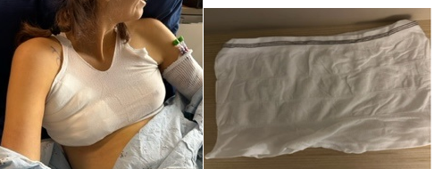
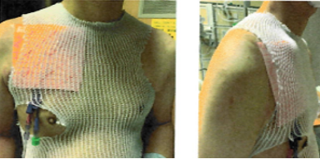
Innovative Nursing Interventions in Challenging Skin Conditions Deborah Bolton, MN, RN, CNS-FNP, AOCNS, AOCNP Kaiser Permanente, Oakland, CA; Tenzin Lungkhawa, MSN-AH, RN, Kaiser Permanente, Oakland, CA
Background and Significance
Advancements in medication and diagnostic techniques have introduced new challenges in wound care, particularly concerning skin injuries and exacerbating skin conditions.
The role of nurses becomes crucial in finding innovative and ingenious solutions.
CASE #1
A patient who received HyperCVAD through a tunneled central venous catheter, developed total skin sloughing on and surrounding the catheter insertion site. No dressing tape would adhere as the adhesive qualities aggravated further skin irritation and breakdown.
Intervention: The RN took a multipurpose tubular net and created a vest to hold the non-adhesive soft foam dressing (PolyMem)) CVC dressing in place.
CASE #2: A patient was admitted with NHL, HLH and anasarca, was experiencing excessive drainage from right axillary lymph node dissection wound and a hematoma formation. The patient’s skin was very sensitive, and any application of adhesive tape was leading to further skin redness and irritation, resulting in dressings non-adherence.
Intervention: The RN took a disposable panty and modified it to become a soft bra that held the compression packing and dressing in place.
Purpose
Showcase the creative problem-solving skills of an oncology RN who devised inventive solutions to manage challenging skin conditions.
Present two cases highlighting the RN’s engineering ingenuity and resourcefulness in delivering patient-centered care.
Interventions / Evaluation
Neither patient experienced further wound exacerbation.
Both designs were easy for RN colleagues to replicate.
Discussion
There is an invaluable role of nursing in adapting and inventing solutions to meet the unique challenges posed by evolving medical conditions and treatments.

