Slide 1

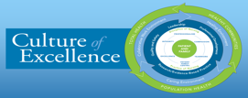

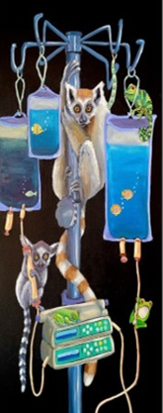
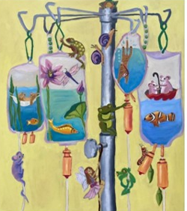
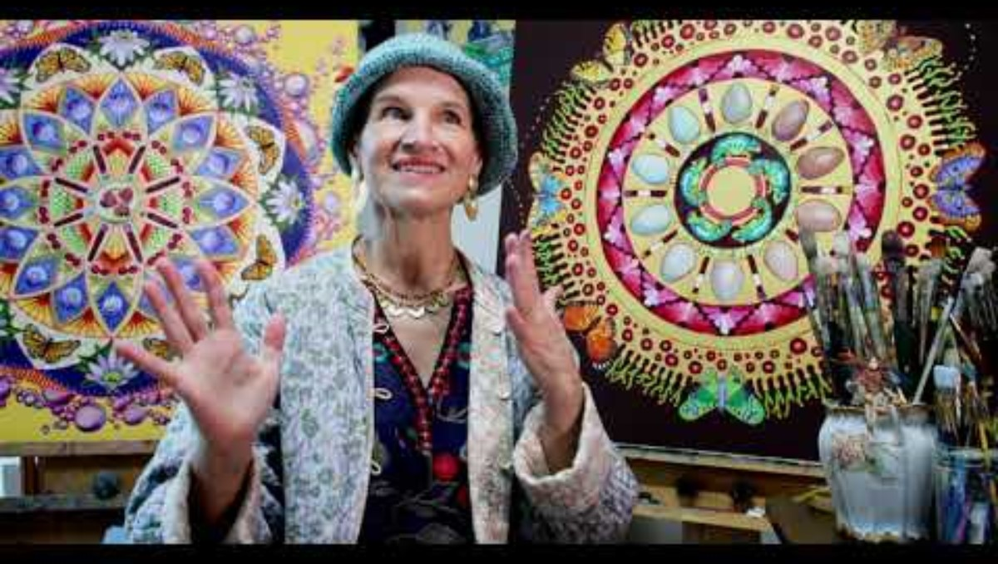
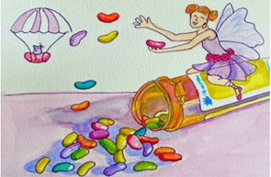
Art Journey: Transforming Challenges into Healing Expériences
From A Patient’s Point of View
Deborah L. Bolton, MN, RN, AOCNS, AOCNP, Julie Ann Accornero- Artist and
10 South Oncology Nurses Kaiser Permanente Oakland California
Discussion: This program highlights the transformative power of art therapy in the context of leukemia treatment. The patient's artistic journey, characterized by her use of the mandala art technique, personal imagery, movement, and music, serves as an inspirational example of how creativity can be harnessed to navigate challenging medical experiences, providing hope and healing.
Background and Significance
Art therapy has proven to be a valuable form of supportive therapy for adult and pediatric patients facing the challenges of leukemia or lymphoma diagnosis, treatment, and recovery.
This presentation explores the inspiring journey of a patient who leveraged her artistic talents to transform difficult situations into positive and healing experiences.
Interventions
Integration into various initiatives to promote art therapy within Adult and Pediatric Cancer Services such as:
Albums
Catalog for Patient Selection for Hospital Room Door
Hospital Art Show and Artist Interview/video:
[9:04 AM] Kenneth S. Poon: Julie Ann Accornero (JulieAnnAccornero.com)Video by: @LicolnAdler (LincolnAdler.com)Music by...
Acknowledgment Lincoln Adler, Musician, and Husband. JulieAnnAccorner.com julieannaccorner@gmail.com; and https://www.youtube.com/watch?v=xpMsWjlLn50
Purpose
The highlighting of the remarkable story of a patient who used her artistic talents to navigate the complexities of treatment for leukemia.
The patient’s purpose is threefold:
  Inspirational Sharing
  Motivational
  Hospital/Regional Wide Impact: Beyond the hospital doors
Evaluation:
The artist's whimsical work and positive intentions have encouraged other patients to use art, and, are requesting that selected pieces be shown on their hospital room doors.

