Slide 1
Head and Neck Multidisciplinary Panel Discussion
DR. LAKEDIA BANKS, ANZONETTE PITTET, PRECIOUS RIVERA, ANNIE YUAN

Slide 2
Objectives
1. Recognize AJCC cancer staging of the larynx
2. Identify safety indications and educate patients about total laryngectomies
3. Identify possible side effects of immunotherapy
4. Discuss treatment options that are patient-centered
5. Nutrition: nutrition impact symptoms, nutrition and symptom management, nutrition support through treatment
6. Identify best practices for management of mucositis, skin changes and other toxicities of head and neck radiation
7. Learn the different treatment modalities in head and neck radiation

Slide 3
Case Study
--- Mr. X is a 67 y/o MALE diagnosed with T1N0M0 Stage I SCC (p16 negative) of the left TVF
--- Treatment: XRT 63 Gy in 28 fractions from 4/5/21-5/12/21
--- Symptoms of recurrence in 12/2021
--- Referred to Medical Oncology

Slide 4
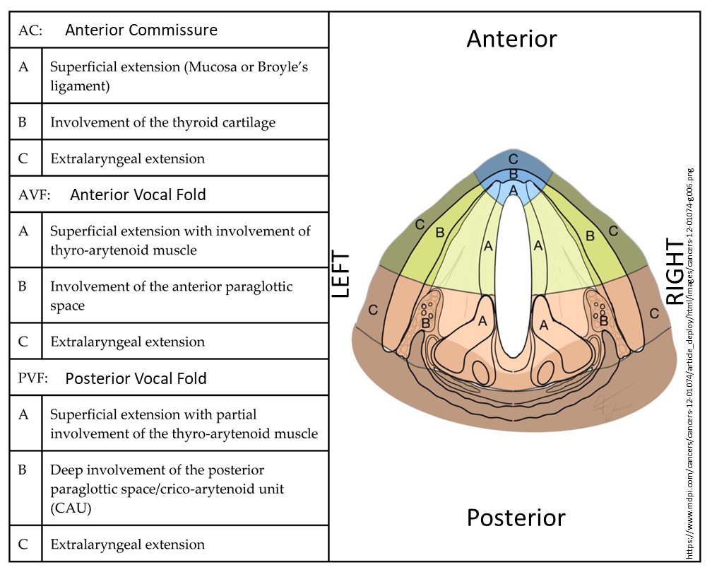
The Larynx
normal - YouTube

Slide 5
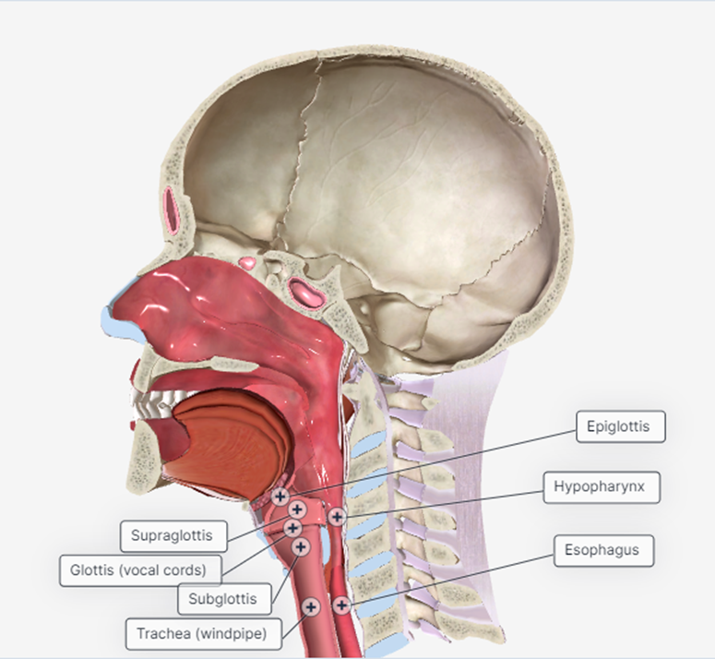
Larynx: Subsites
The supraglottis (the area above the vocal cords)
The glottis (the area that includes the vocal cords)
The subglottis (the area below the vocal cords)

Slide 6
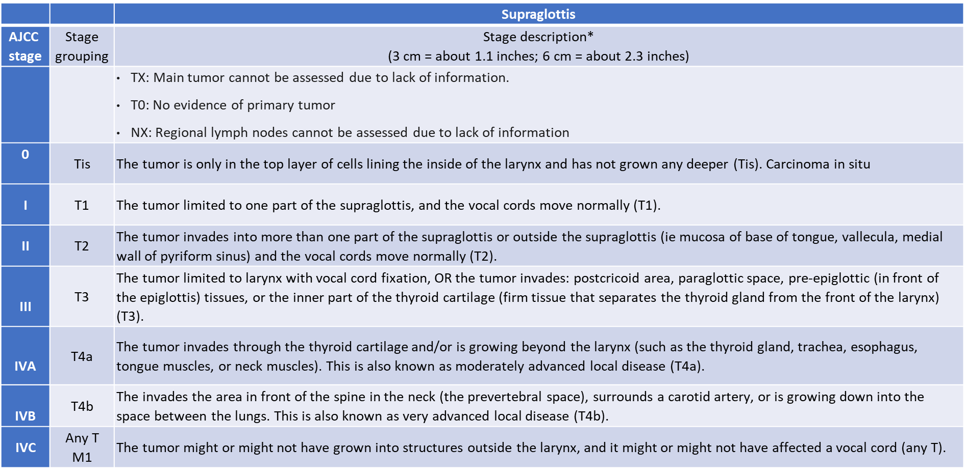
AJCC: Guidelines for T-Stage Laryngeal CA

Slide 7
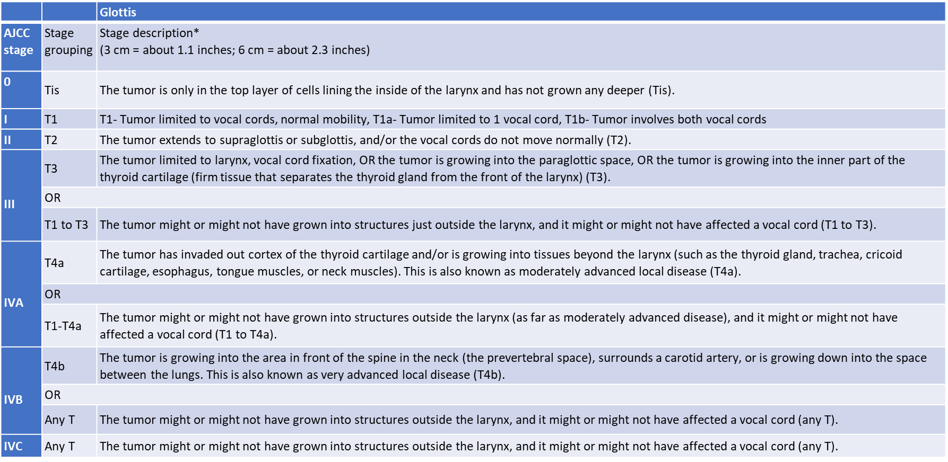
AJCC: Guidelines for T-Stage Laryngeal CA

Slide 8
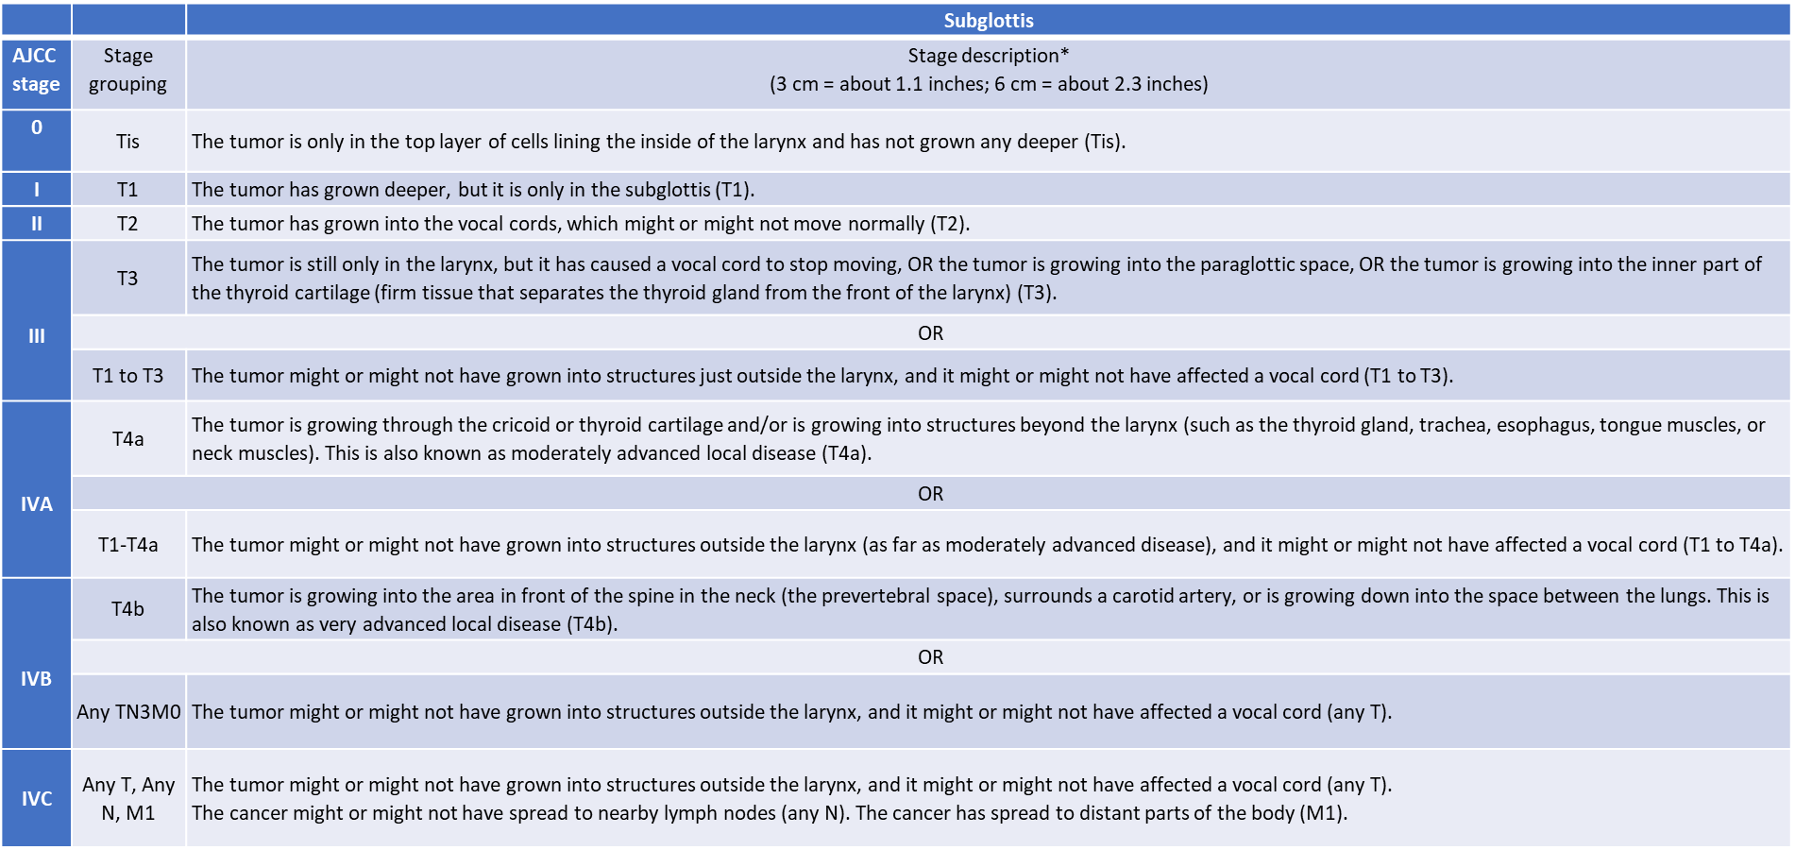
AJCC: Guidelines for T-Stage Laryngeal CA

Slide 9
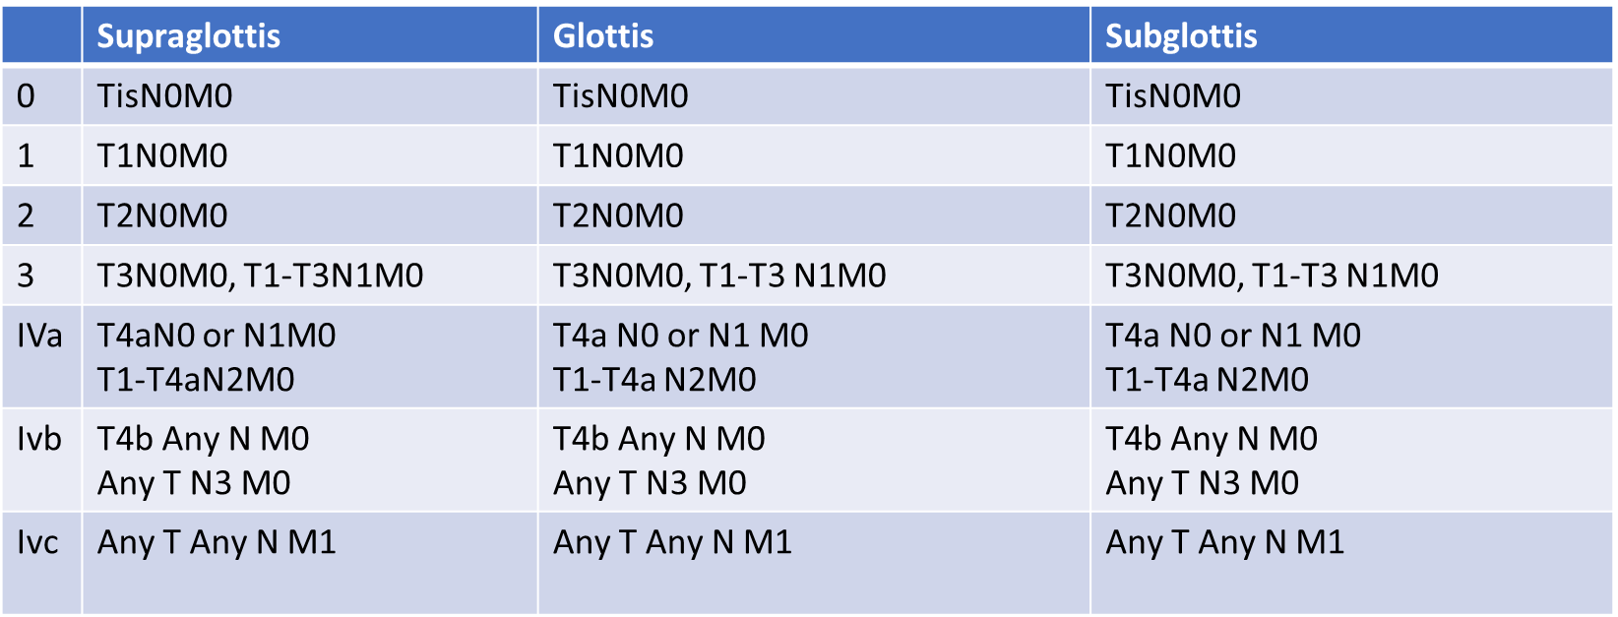
AJCC: Guidelines for TNM-Stage Laryngeal CA

Slide 10
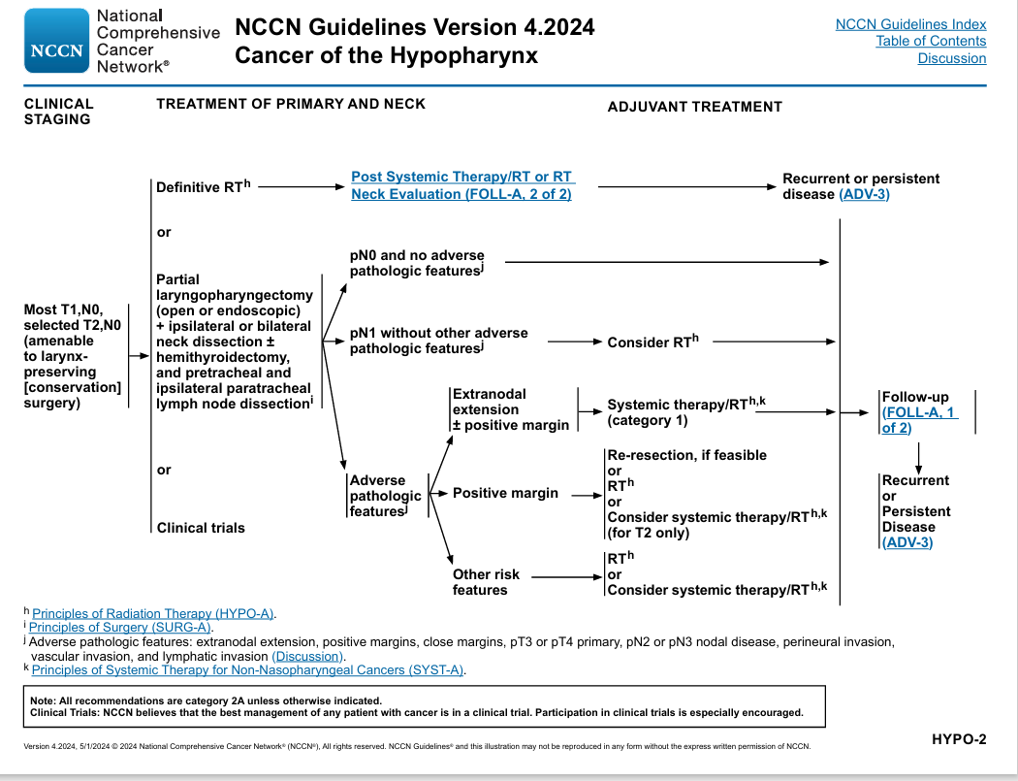

Slide 11
T & N Stage Classification
T N classification | Larynx | Hypopharyx | Total
T1N0 | 42ª | 10 | 52
T1N2 | 0 | 1 | 1
T2N0 | 26^{b} | 0 | 26
T2N2 | 1 | 0 | 1
Total | 69 | 11 | 80

Slide 12
Vocal-cord Only vs. Complete Laryngeal radiation (VOCAL): a randomized multicentric Bayesian phase II trial
Radiotherapy, along with laser surgery, is considered a standard treatment option for patients with early glottic squamous cell cancer (SCC). Historically, patients have received complete larynx radiotherapy (CL-RT) due to fear of swallowing and respiratory laryngeal motion and this remains the standard approach in many academic institutions. Local control (LC) rates with CL-RT have been excellent, however this treatment can carry significant toxicities include adverse voice and swallowing outcomes, along with increased long-term risk of cerebrovascular morbidity. A recent retrospective study reported improved voice quality and similar local control outcomes with focused vocal cord radiotherapy (VC-RT) compared to CL-RT. There is currently no prospective evidence on the safety of VC-RT. The primary objective of this Bayesian Phase II trial is to compare the LC of VC-RT to that of CL-RT in patients with T1N0 glottic SCC.

Slide 13
Definitive radiotherapy of 63 Gy was completed in all patients. The overall treatment time ranged from 38 to 49 days, with a median of 41 days. The most common acute toxicity was mucositis. Mucositis and dermatitis of grade 2 were observed in 77 cases (96%) and 15 cases (19%), respectively. No grade 3 acute toxicity was observed
Acute adverse effects
Grade | 0 | 1 | 2 | 3 | 4
Mucositis | 0 | 3 | 77 | 0 | 0
Dermatitis | 0 | 65 | 15 | 0 | 0

Slide 14
Radiotherapy with fraction size of 2.25 Gy in T1-2 laryngeal and hypopharyngeal cancer
This study was carried out to evaluate the influence of fraction size 2.25 Gy on local control of T1 and T2 laryngeal and hypopharyngeal cancers. Between August 2002 and December 2010, 80 patients with T1 and T2 laryngeal or hypopharyngeal cancers were treated with definitive radiotherapy with a fraction size of 2.25 Gy. Primary sites were the larynx in 69 and the hypopharynx in 11. Fifty-three patients were T1 and 27 were T2. All patients' pathology was squamous cell carcinoma except one carcinosarcoma. Radiotherapy was delivered 5 days/week with a 4-MV photon beam up to a total dose of 63.0 Gy.

Slide 15
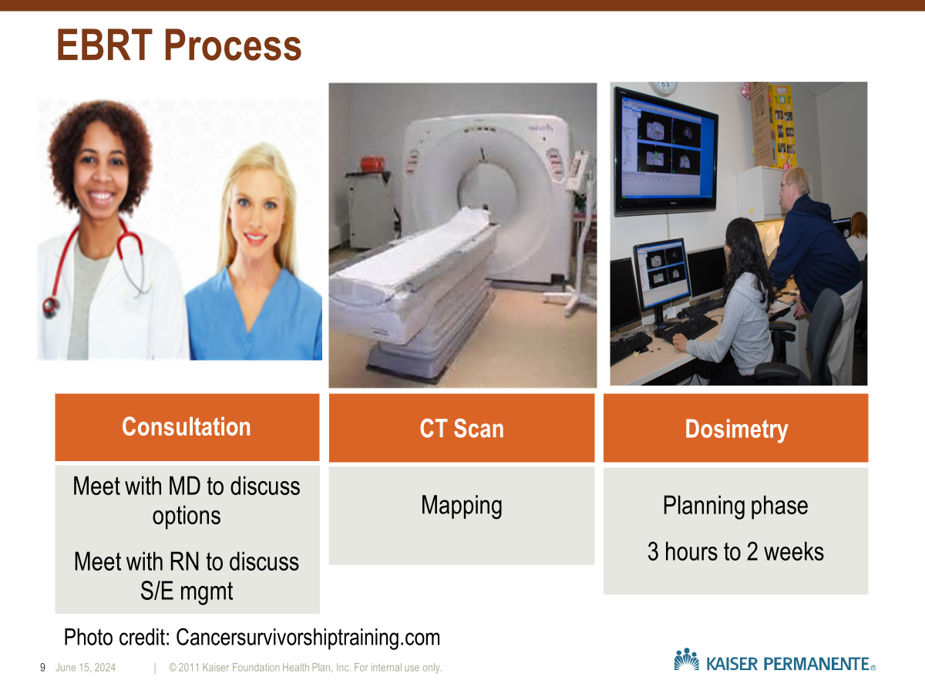

Slide 16
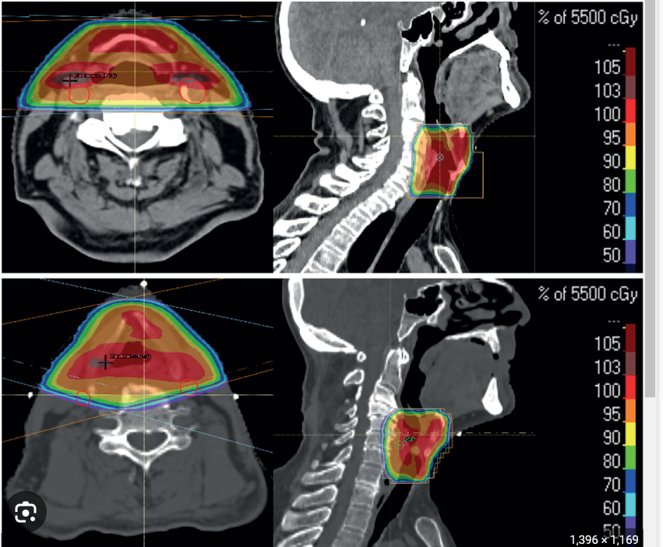

Slide 17
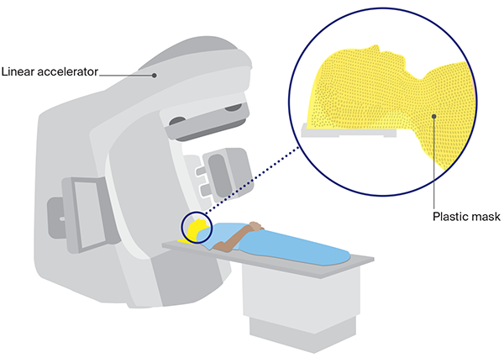


Slide 18
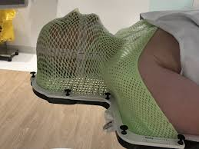

Slide 19
https://youtube.com/clip/Ugkx17kLRv6V10I_e0TBKcV2QkvgsOfJ85rn?feature=shared

Slide 20
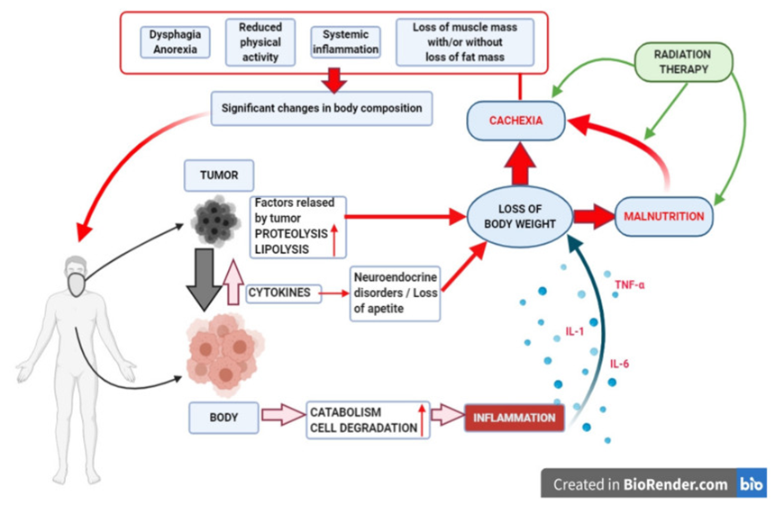
Head and Neck Cancer - Nutrition
Tx impact on nutrition status:
•Pre-existing malnutrition at Dx (50-70%)
•Malnutrition 2/2 Tx (44-88%)
•Body composition: Cachexia, Sarcopenia (16-71%)
•Change in body mass is similar to what is observed after severe burn injury:
•Body fat is preserved at expense of skeletal muscle
•May persist for as long as year after Tx completion
•Catabolic and inflammatory response impacts effectiveness of treatment and can shorten survival
•Acute and delayed treatment toxicity impact on QOL during Tx and long term survivorship
•Von Meyenfeldt M. Cancer-associated malnutrition: An introduction. Eur. J. Oncol. Nurs. 2005;9:S35–S38
•Siddiqui F., Movsas B. Management of Radiation Toxicity in Head and Neck Cancers. Semin. Radiat. Oncol. 2017;27:340–349

Slide 21
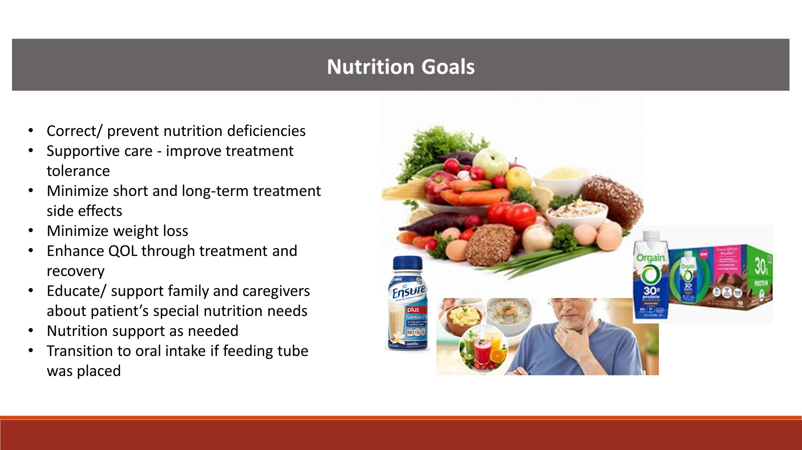

Slide 22
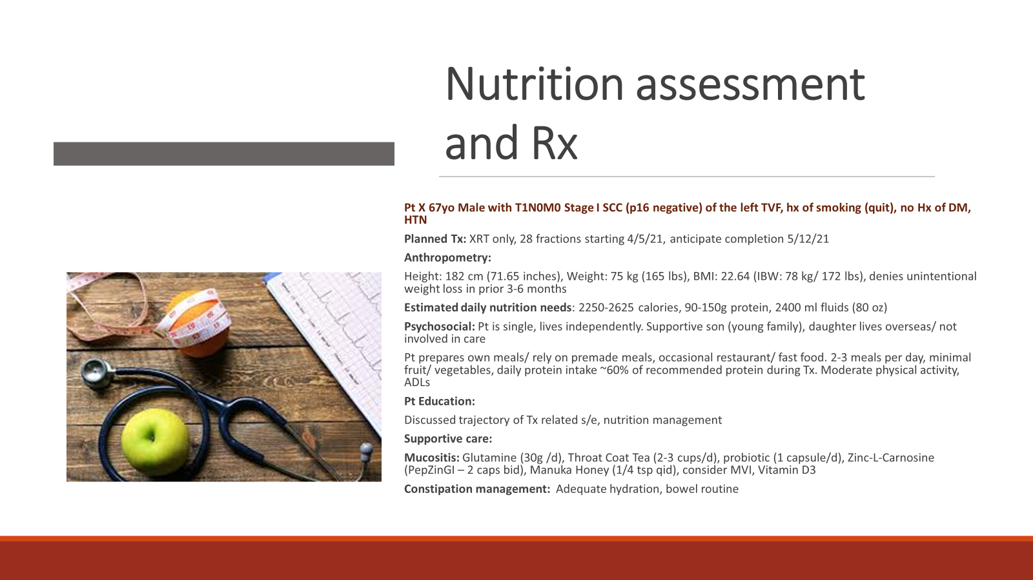

Slide 23
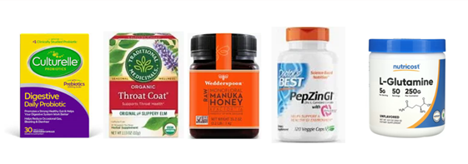
Nutrition Rx/ Supportive care
Daily foods (2420 calories, 140g protein)
Protein:
2 eggs
2 Tbsp nut butter or 1 oz nuts
3 servings whole milk dairy including 1 serving Greek yogurt
4 oz salmon or 1 ¾ c lentils/ beans
4 oz chicken/ beef/ pork/ ¾ block tofu
Grains:
1c cooked oats
1c cooked rice/ pasta
1c cooked potato/ sweet potato
Fruit:
1 medium banana
1c melon
Vegetables:
2 cups vegetables
Fats:
3 tbsp (olive oil, avocado oil)
Hydration: 2400 ml/d or 80 oz
Supportive care:
•Probiotic (1 capsule/d)
•Throat Coat Tea (2-3 cups/d)
•Zinc-L-Carnosine (PepZinGI – 2 caps bid)
•Manuka Honey (1/4 tsp qid)
•Glutamine (30g /d)

Slide 24



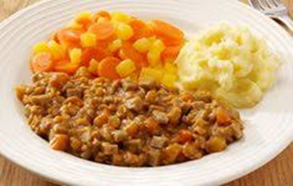


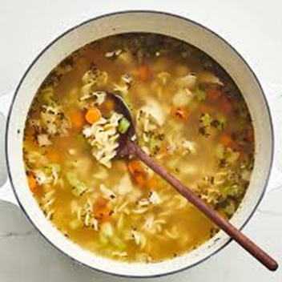
Nutrition Rx
Daily foods (2420 calories, 140g protein)
Protein:
2 eggs
2 Tbsp nut butter or 1 oz nuts
3 servings whole milk dairy including 1 serving Greek yogurt
4 oz salmon or 1 ¾ c lentils/ beans
4 oz chicken/ beef/ pork/ ¾ block tofu
Grains:
1c cooked oats
1c cooked rice/ pasta
1c cooked potato/ sweet potato
Fruit:
1 medium banana
1c melon
Vegetables:
2 cups vegetables
Fats:
3 tbsp (olive oil, avocado oil)

Slide 25
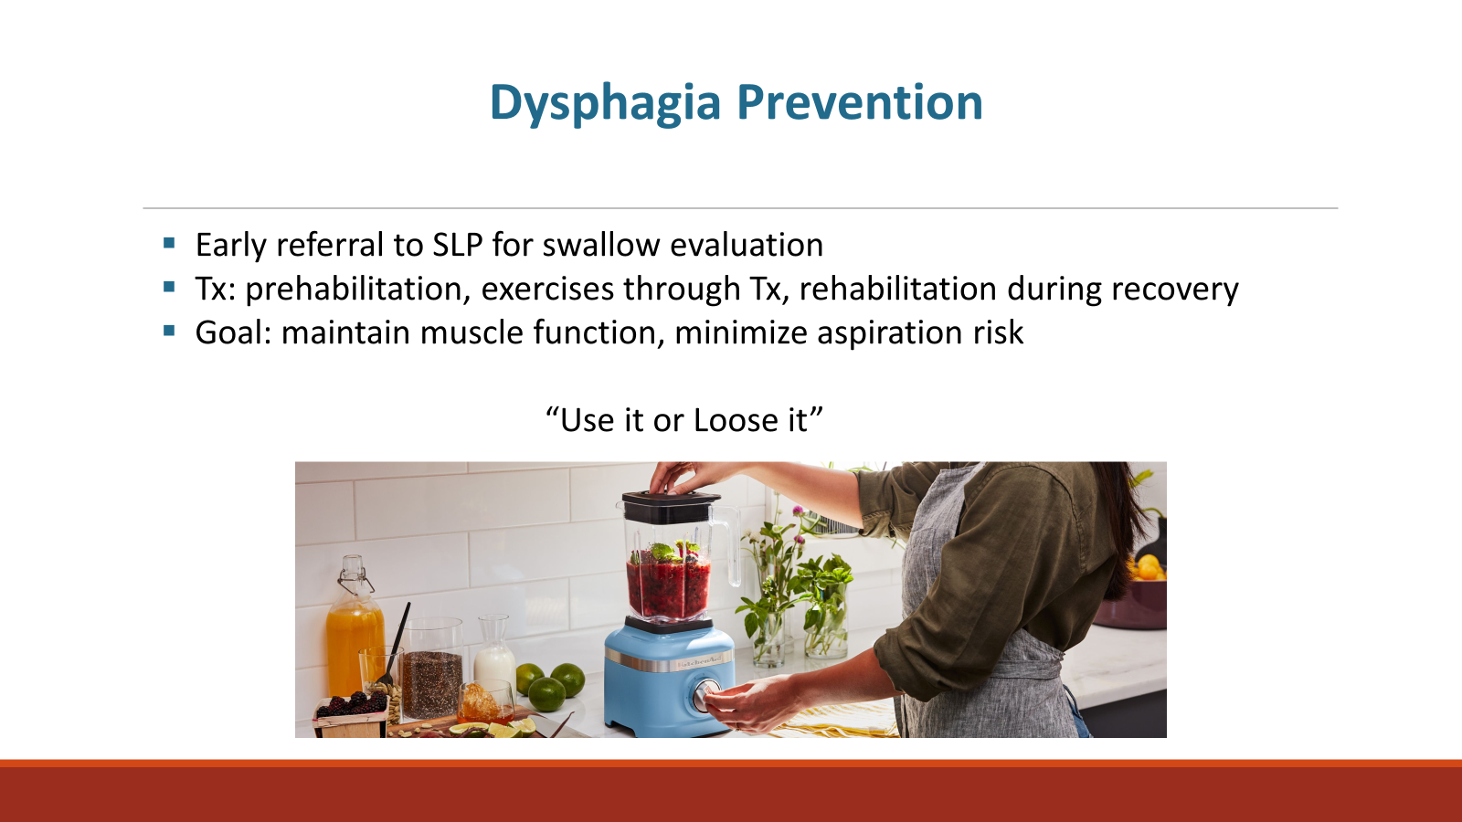

Slide 26
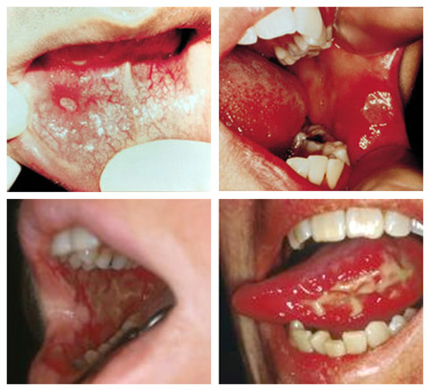
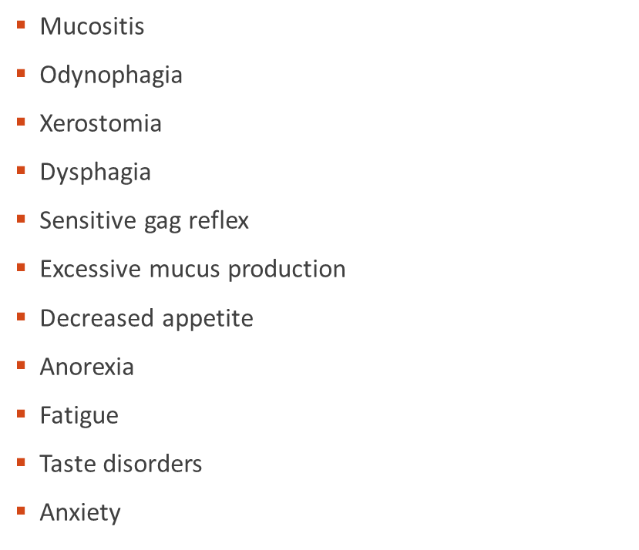
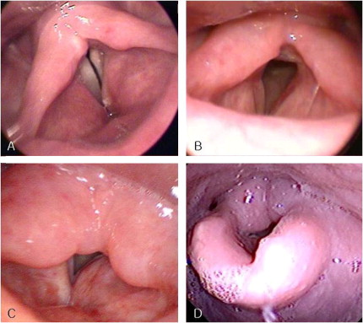
Acute side effects that impacts nutrition

Slide 27
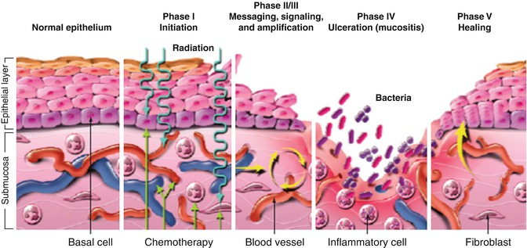
Pathophysiology of Mucositis

Slide 28
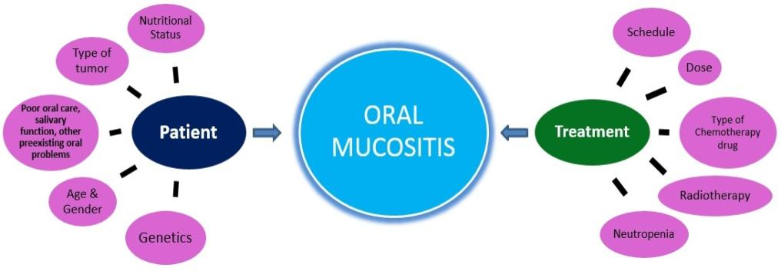
Risk Factors of Mucositis

Slide 29
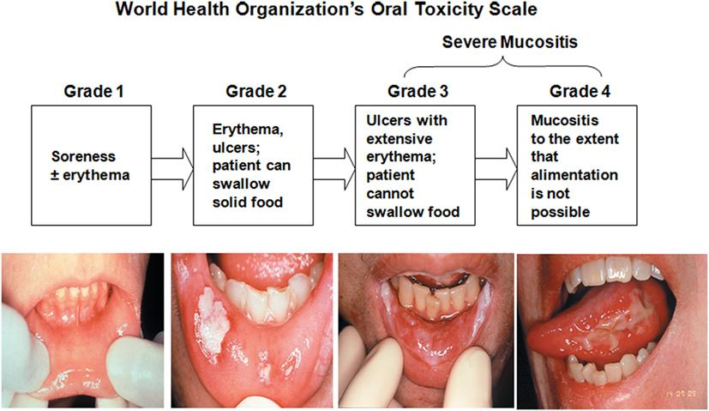
Mucositis

Slide 30
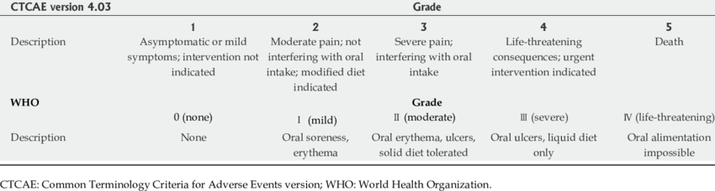
CTCAE & WHO GRADING SYSTEMS

Slide 31
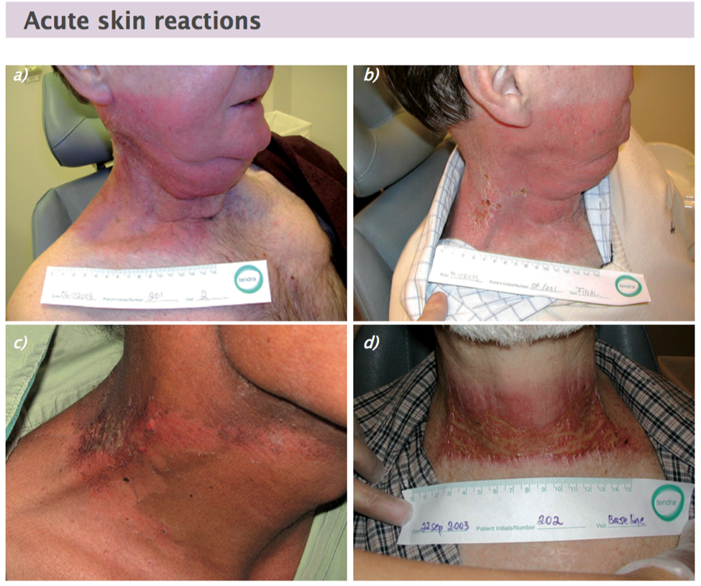
Figures courtesy of Lena Shar

Slide 32
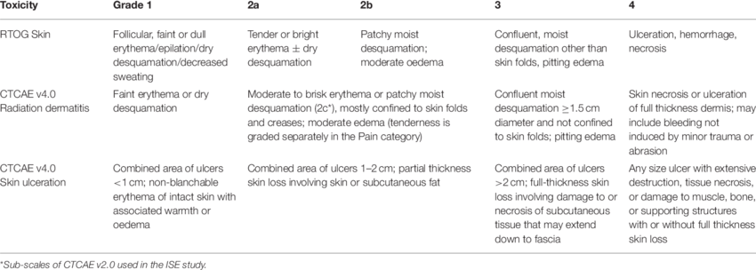
CTCAE Erythema Grading System

Slide 33
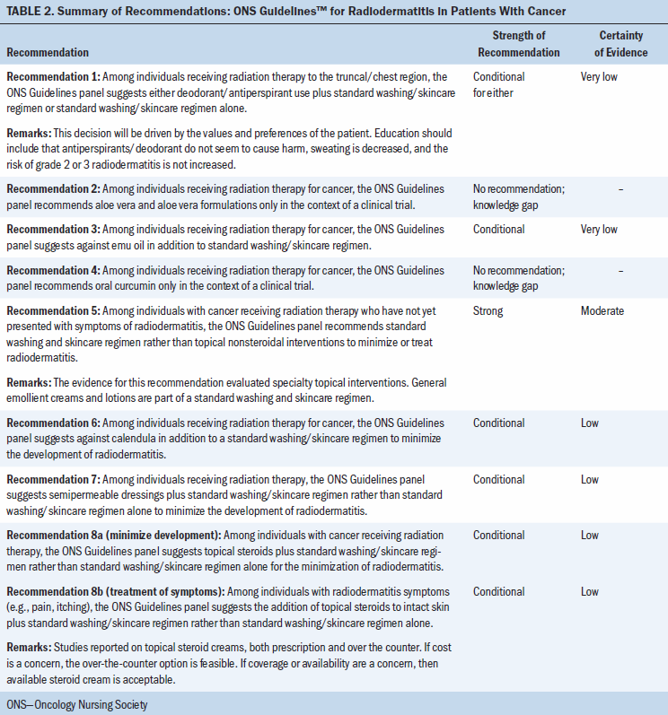

Slide 34
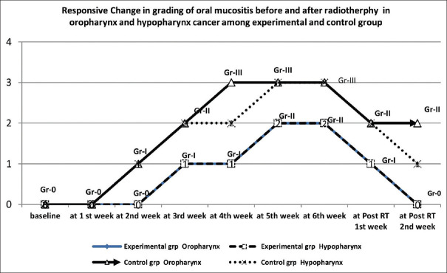
Supportive care: Zinc
Essential trace element
Diverse physiological process such as:
  growth and development
  maintenance and priming of the immune system
  tissue repair
  structural constituent of many proteins
  regulatory ion for the stability of proteins and in preventing free radical formation
Zinc sulfate: Dosing 150 mg once daily
Anandhi P et al. The Benefit of Zinc Sulfate in Oropharyngeal Mucositis during Hyperfractionated Accelerated Concomitant Boost Radiotherapy with Concurrent Cisplatin for Advanced-Stage Oropharyngeal and Hypopharyngeal Cancers. Indian J Palliat Care. 2020 Oct-Dec;26(4):437-443

Slide 35
Supportive care: Zinc
Zinc as a complementary treatment for cancer patients: a systematic review
Zinc substitution is able to help in protection against radiotherapy-induced inflammation of oral and oropharyngeal mucosa
No improvement is given in cases of mucositis due to chemotherapy
We have registered trends to less loss of taste and dry mouth during radiotherapy as well as mucositis-related oral pain
Zinc has no impact on the survival of tumour patients, e.g. it will not decrease the effect of basis anti-cancer therapy
Hoppe, C., Kutschan, S., Dörfler, J. et al. Zinc as a complementary treatment for cancer patients: a systematic review. Clin Exp Med 21, 297–313 (2021

Slide 36
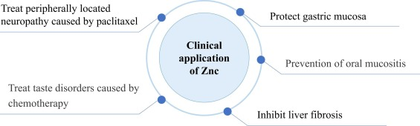
Supportive care: Zinc
Zinc carnosine: Frontiers advances of supplement for cancer therapy
Evidence supports ZnC in:
Maintaining, preventing, and treating mucosal damage as well as epithelial tissue
Supporting its permissible application to be a dietary Zn supply in the United States for radiation therapy as well as gastric ulcer
This reveals other uses, especially for the treating approach of oral mucositis and taste disorders in carcinoma cases undergoing radiation therapy and therapy with the use of chemical substances
The outcomes suggested on effectiveness more specifically support the inflammation resistance and oxidation resistance mechanisms of ZnC
Weiwei Tang et al. Zinc carnosine: Frontiers advances of supplement for cancer therapy, Biomedicine & Pharmacotherapy, Volume 151 (2022), 113157
Notes:
A beneficial role for prophylactic oral zinc sulfate was suggested in a trial that randomly assigned 30 patients receiving RT for HNC to zinc sulfate (220 mg [50 mg elemental zinc] three times daily) or placebo, during and for six weeks after RT. The severity of mucositis was significantly less in the zinc group (grade 3 or 4 in 0 versus 8 patients); furthermore, mucositis developed later, and started to improve earlier with zinc.

Slide 37
Supportive care: Glutamine
Glutamine for prevention and alleviation of radiation-induced oral mucositis in patients with head and neck squamous cell cancer: Systematic review and meta-analysis of controlled trials
Meta Analysis of RCT’s
Glutamine substantially reduced the severity of radiation-induced OM, as reflected by the reduced incidence of severe OM and reduced mean maximal OM grade score
Significantly decreased:
  the rates of analgesic opioid use
  nasogastric tube feeding
  therapy interruptions
Oral glutamine supplementation demonstrated various therapeutic benefits in preventing and ameliorating radiation-induced OM among patients with H&N cancer.
Alsubaie, HM et al. Glutamine for prevention and alleviation of radiation-induced oral mucositis in patients with head and neck squamous cell cancer: Systematic review and meta-analysis of controlled trials. Jnl of the Sciences and Specialties of Head and Neck, Oct 2021, Vol 43, Issue 10:31909-3213
Notes:
Glutamine, one of the most abundant amino acids in your body is an important building block of protein. It plays an important role in muscle development and maintenance.

Slide 38

Supportive care: Manuka honey
Manuka honey is collected from beehives around the Manuka bush (Leptospermum scoparium), a plant indigenous to Australia and New Zealand
It has been used both as food and as a topical treatment for wounds, burns, and ulcers.
Preclinical findings indicate antibacterial
Anti-inflammatory
Antioxidant
Anti-ulcer
Effectiveness against several antibiotic-resistant bacteria
Manuka Honey | Memorial Sloan Kettering Cancer Center (mskcc.org)

Slide 39
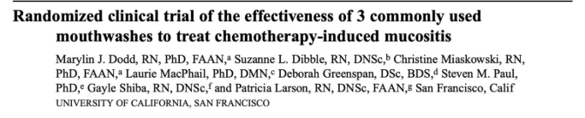
Mucositis: Magic Mouthwash Patients 200 patients receiving chemotherapy known to cause mucositis ▪ Had mucositis at study entry Excluded if getting radiation Intervention Randomized to 12 days of one of three mouth washes: › Salt and baking soda › Chlorhexidine gluconate 0.12% › Magic mouthwash • 25% lidocaine 0.5% • 1.25% Benadryl • 73.75% Maalox
Mucositis: Magic Mouthwash Results ▪ Similar time to resolution of signs/symptoms: mean in the 3 groups ranged from 6.6-6.2 days, p=0.59) ▪ No large difference in mean pain scores between groups, p=0.75 My conclusions ▪ Potential criticisms: › This Magic Mouthwash had very little lidocaine › Other rinses were both active against mucositis (no placebo arm)

Slide 40
Magic Mouthwash
Many names/formulations
Magic Mouthwash, Triple mix, BMX , Noll’s solution, Pink lady, Magic swizzle
Often includes ingredients such as:
antihistamine (such as diphenhydramine/Benadryl), antacid (such as Maalox), numbing (such as lidocaine)
antifungal (such as nystatin)
antibiotic (such as tetracycline)
steroid (such as dexamethasone)
coating agent (such as sucralfate)

Slide 41
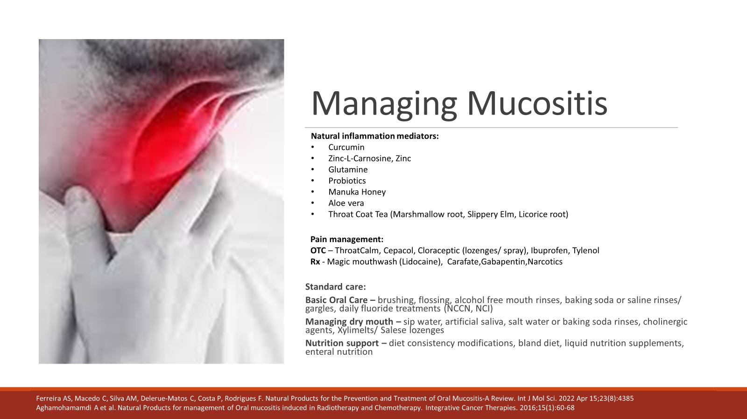

Slide 42
Work up
Scope exam: Different patient but similar circumstance: https://youtu.be/a_LGKVqsIlQ
  Exophytic friable mass involving entire length of the left true vocal fold extending to the false fold and supraglottis
  Left true vocal fold is immobile
  Glottic airway patent
  Imaging:
  PETCT 12/2021: Increased uptake noted throughout the left true vocal cord which measures 17x13 mm, SUV8.4.
  Stable appearance of multiple nodules in the right long tracking along the anterior right minor fissure. None demonstrate increased metabolic activity. Largest is 16x11 mm

Slide 43
Pathology and Plan
Biopsy done on 3/11/22
DIAGNOSIS:
VOCAL CORD MASS, LEFT TRUE AND FALSE VOCAL CORD, BIOPSY (A)
-- RECURRENT SQUAMOUS CELL CARCINOMA
VOCAL CORD, LEFT TRUE, BIOPSY (B)
-- RECURRENT SQUAMOUS CELL CARCINOMA
ANTERIOR COMMISSURE OF LARYNX, BIOPSY (C)
-- RECURRENT SQUAMOUS CELL CARCINOMA
VOCAL CORD, LEFT FALSE, BIOPSY (D)
-- RECURRENT SQUAMOUS CELL CARCINOMA
• Plan: crT2 vs T3, N0, M?, Laryngectomy

Slide 44
AJCC: Guidelines for T-Stage Laryngeal CA

Slide 45
AJCC: Guidelines for TNM-Stage Laryngeal CA

Slide 46
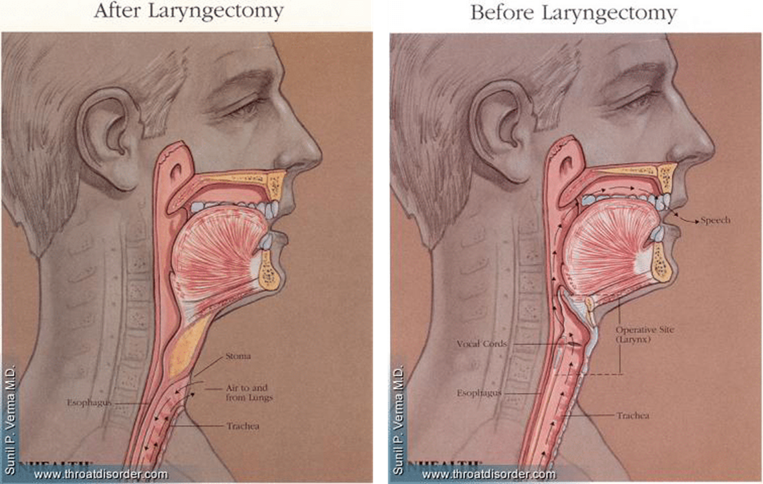
Salvage Total Laryngectomy
https://www.youtube.com/watch?v=5zWB4dLYChM
Surgical removal of voice box
Separation of esophagus and voice box
Scope exam after TL:
https://youtu.be/d1C3p3iOQRQ
Scope through stoma after TL:
https://youtu.be/54mlsao6qKY

Slide 47
Patient factors
**CANNOT INTUBATE FROM ABOVE. NECK BREATHER**
Laryngectomy ≠ Tracheostomy
What to expect after surgery
  Cannot speak after surgery
  Voice will not be the same EVER
  Swallowing function intact but will feel different
  Once healed, no risk of aspiration
Safety Measures
  Ability to call for help in an emergency
  Medical alert bracelets- be mindful that patient may not be able to speak, will need one that doesn’t require speaking
  Cannot ever submerge under water, no water activities
  Cannot intubate from above

Slide 48
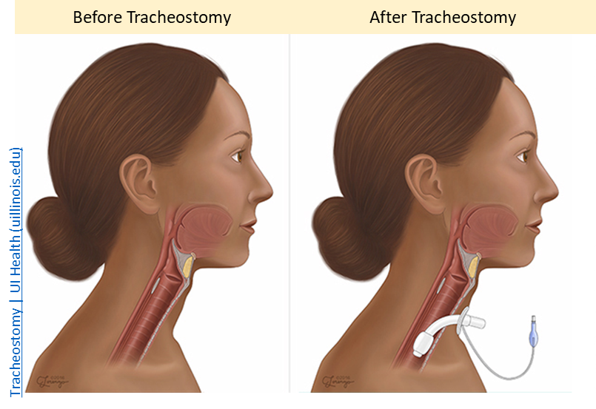
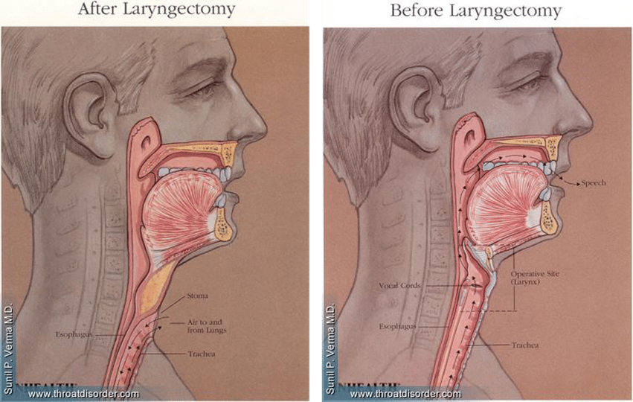
Laryngectomy ≠ Tracheostomy
Tracheostomy
Laryngectomy
- CAN breathe through nose and mouth
- CAN intubate from above
- CAN aspirate
- NECK BREATHER, canNOT breathe through nose/mouth
- canNOT intubate from above
- canNOT aspirate

Slide 49
Surgical Pathology, 3/18/22, TL
DIAGNOSIS:
LARNYNX, TOTAL LARYNGECTOMY
-- RECURRENT/RESIDUAL MODERATELY DIFFERENTIATED INVASIVE SQUAMOUS
CELL CARCINOMA, 2.5 CM, WITH INVOLVEMENT OF CRICOID CARTILAGE
-- MARGINS UNINVOLVED BY CARCINOMA
LYMPH NODES, RIGHT LEVEL II, NECK DISSECTION
-- FIVE LYMPH NODES, NEGATIVE FOR CARCINOMA (0/5)
LYMPH NODES, RIGHT LEVEL III, NECK DISSECTION
-- SEVEN LYMPH NODES, NEGATIVE FOR CARCINOMA (0/7)
LYMPH NODES, RIGHT LEVEL IV/V, NECK DISSECTION
-- TEN LYMPH NODES, NEGATIVE FOR CARCINOMA (0/10)
LYMPH NODES, LEFT LEVEL II, NECK DISSECTION
-- ONE LYMPH NODE, NEGATIVE FOR CARCINOMA (0/1)
LYMPH NODES, LEFT LEVEL III, NECK DISSECTION
-- THREE LYMPH NODES, NEGATIVE FOR CARCINOMA (0/3)
LYMPH NODES, LEFT LEVEL IV/V, NECK DISSECTION
-- SEVEN LYMPH NODES, NEGATIVE FOR CARCINOMA (0/7)
Procedure: Total laryngectomy
Tumor site (including laterality): Left glottis, true vocal fold
Tumor focality: Single focus
Tumor size (cm): 2.5 x 2.3 x 0.6 cm
Histologic type: Squamous cell carcinoma
Histologic grade: Moderately differentiated
Tumor extension (other structures/spaces involved): Transglottic extension present, Thyroid and cricoid cartilage involved
Margin status: Uninvolved (closest margins, <0.1 cm from level 6 strap muscle, 0.3 cm from orange-inked left mucosal margin)
Lymphovascular invasion: Present
Perineural invasion: Present
Regional lymph node status: Negative (0/33)
TNM Staging (AJCC 8th ed.): ypT4a pN0

Slide 50
AJCC: Guidelines for T-Stage Laryngeal CA

Slide 51
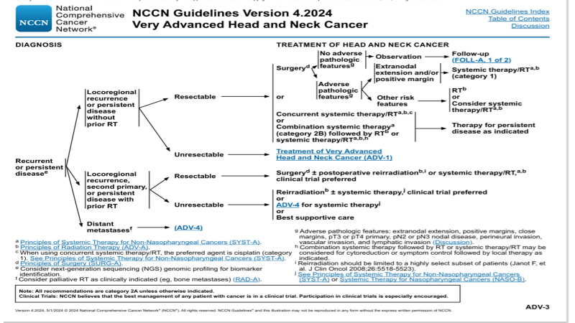

Slide 52
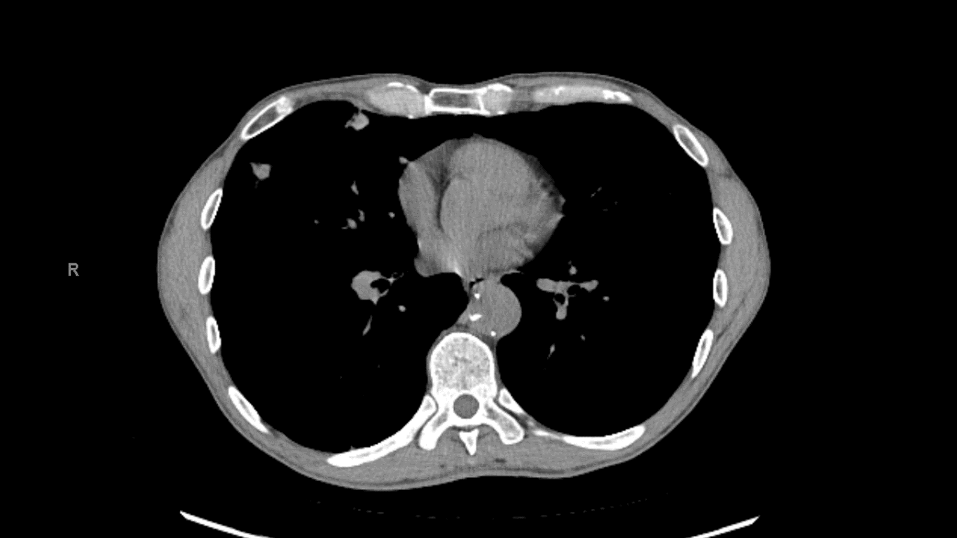

Slide 53
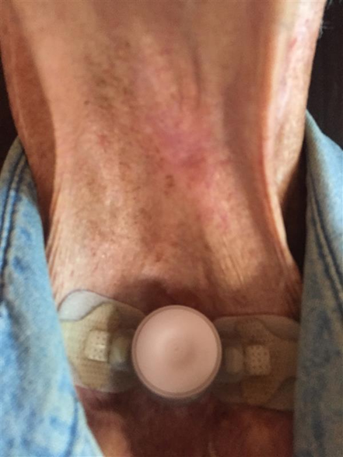
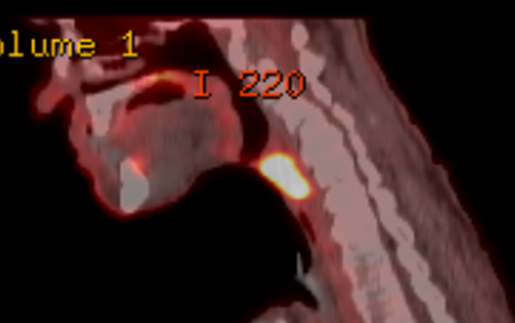
Recurrence #3
• 8/1: first discovered redness
9/12/23: redness and dysphagia → FNA and PETCT, declined NGT or GT
Pathology:
DIAGNOSIS:
MIDLINE NECK MASS, FINE NEEDLE ASPIRATION
-- INVOLVED BY SQUAMOUS CELL CARCINOMA
PETCT

Slide 54
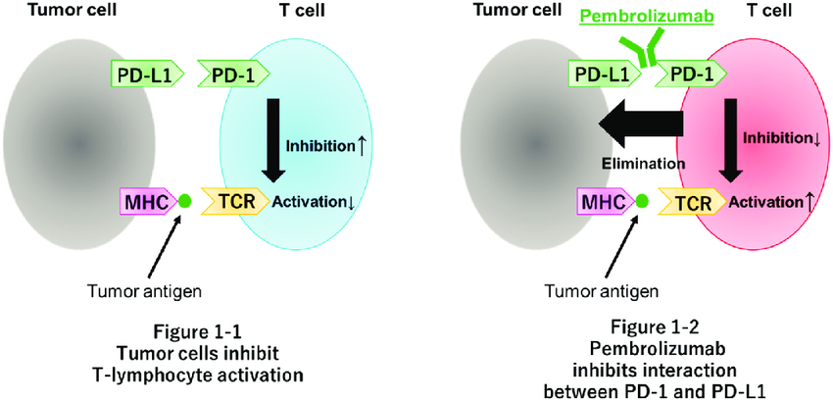
Immunotherapy
KEYNOTE-048
  Pembrolizumab
  PD-L1 Score: 20 or CPS 1
  Alone or in combination with chemotherapy
    ↑ OS
    ↑ DOR

Slide 55
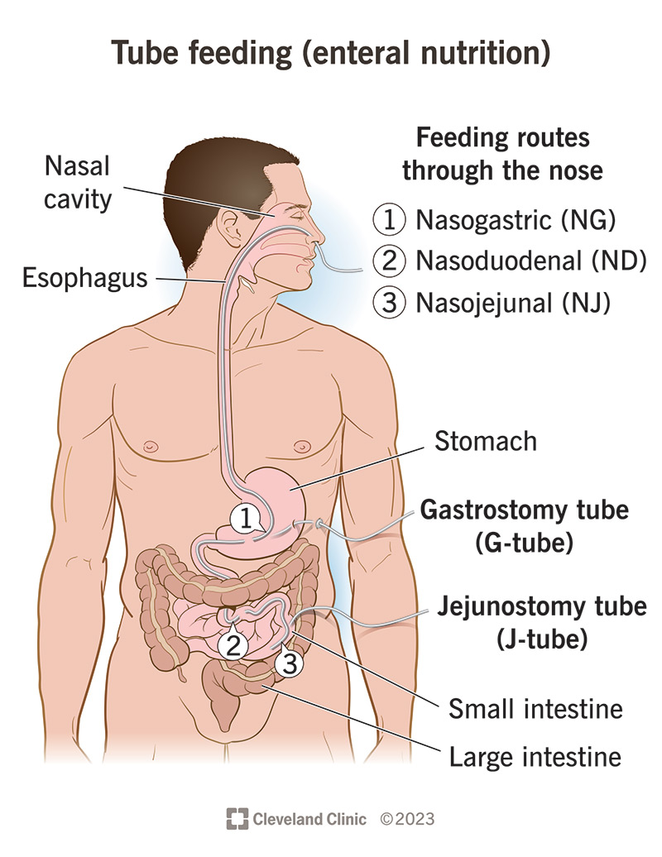
Feeding tubes
ASPEN recommendation:
Enteral nutrition is appropriate for pts receiving anticancer Tx who are malnourished and not expected to be able to take adequate nutrition for a prolonged time
Oral nutrition > Enteral nutrition > Parenteral nutrition
Nasogastric or Gastrostomy tubes?
Prophylactic tube placement vs responsive feeding tube placement
Duration of feeding tube use
Gastrostomy Placement: GI, IR, Sx
RD referral
Supplies
Monitoring

Slide 56
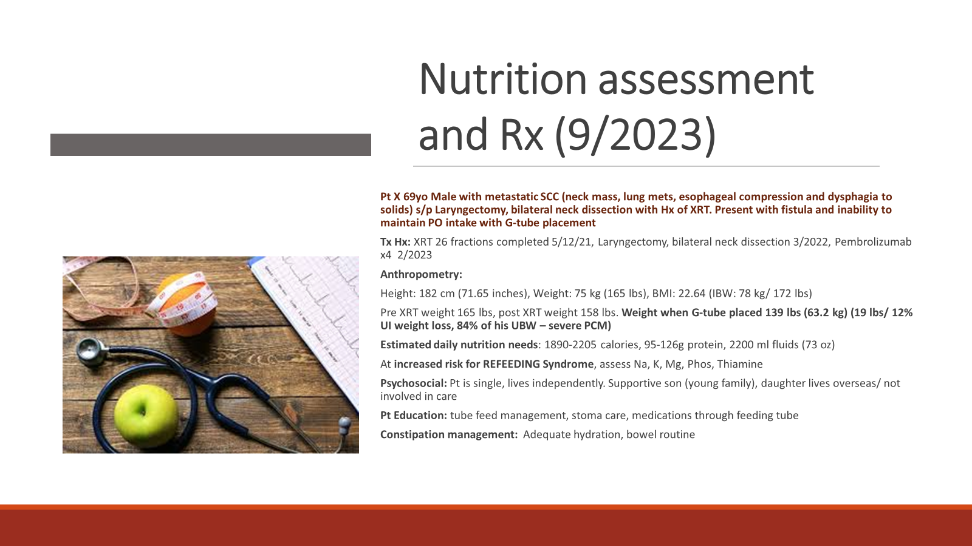

Slide 57
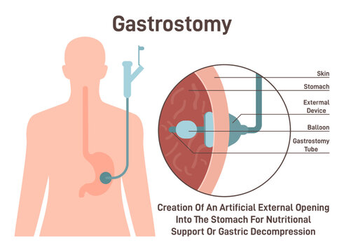
Tube feeding
During Admission
Initiate tube feeds and monitor labs to manage REFEEDING SYNDROME (Na, K, Mg, Phos, Thiamine)
Replete nutrients as needed while increasing tube feeds to
goal rate/ volume (Bolus feeds)
Monitor tolerance
Educate pt and family regarding tube feeding procedures
Order appropriate supplies
Refer to outpatient RD/ HH RD who will FU after discharge
Monitor patient as outpatient

Slide 58
Tube feeding Rx
Nutrition needs: 1890-2205 calories, 95-126g protein, 2200ml fluids
Tube feeds
  4 cartons Nutren 2.0/day (2000 calories, 100g protein, 692 ml FW), provide 125% of DRI’s for 23 vitamins/ minerals
  Additional hydration: 1500 ml
  3 Bolus feeds: 1 ½ cartons, 1 ½ cartons, 1 carton
  Water flushes: 60 ml ac/ pc feeds, 1140 ml for medication administration (~400 ml) / hydration (250 ml tid between feeds)
  Method: gravity feeds
  Considerations: bowel routine (fiber, stool softeners, laxatives)
DME Supplies: stoma care (dressings), tube feeds (formula, syringes, gravity bags, IV pole, hemostat/ stop cock)
Post discharge: follow up by HHRD/ Outpatient RD

Slide 59
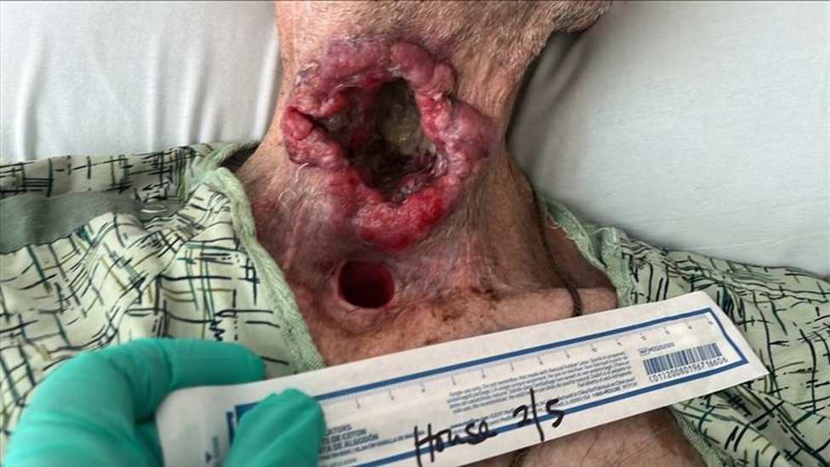
Fistula Secondary to Treatment/Cancer

