Slide 1
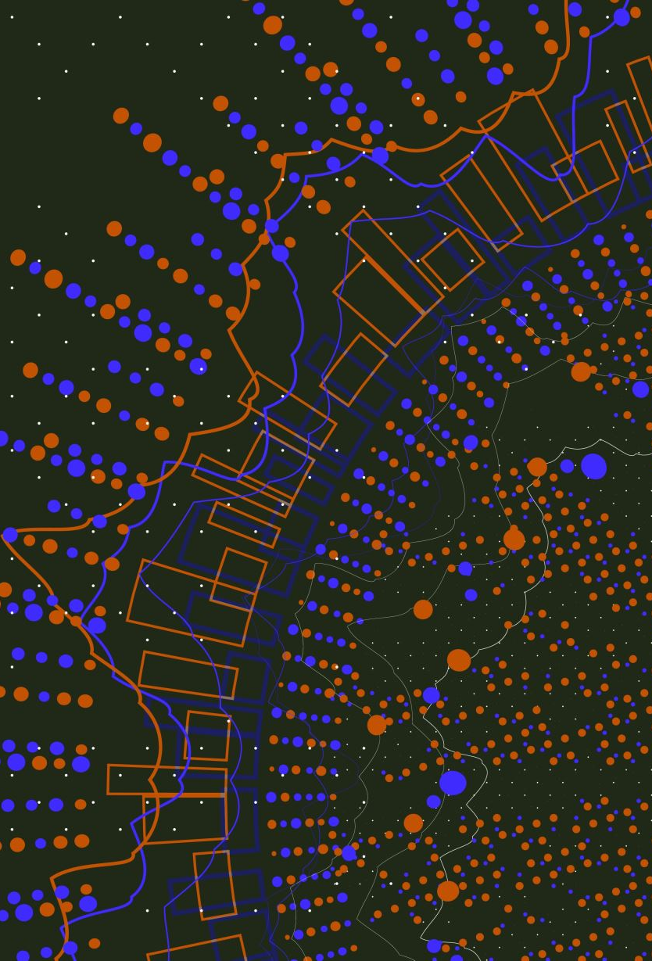
Empowering Oncology Nurses:
Navigating Precision Medicine in Cancer Care
Frank dela Rama, RN, MS, AOCNS, AGN-BC
Clinical Nurse Specialist, Oncology/Genomics
Sutter Palo Alto Medical Foundation
Senior Oncology Nurse Guide
Navvisa.com
Presented to the SVONS -- June 2024
Notes:
FRANK – intro
AONN member since inception
PCNN to genetics nurse
New grads/veterans
Years ago – here Genetics 101 / today = recent developments, emerging tech (iphone X to 11 – features you didn’t even know you wanted)
IN THE CHAT – specialty navigated, yrs in oncology, is genetics / genomics part of your practice Y or N
- questions OK throughout

Slide 2
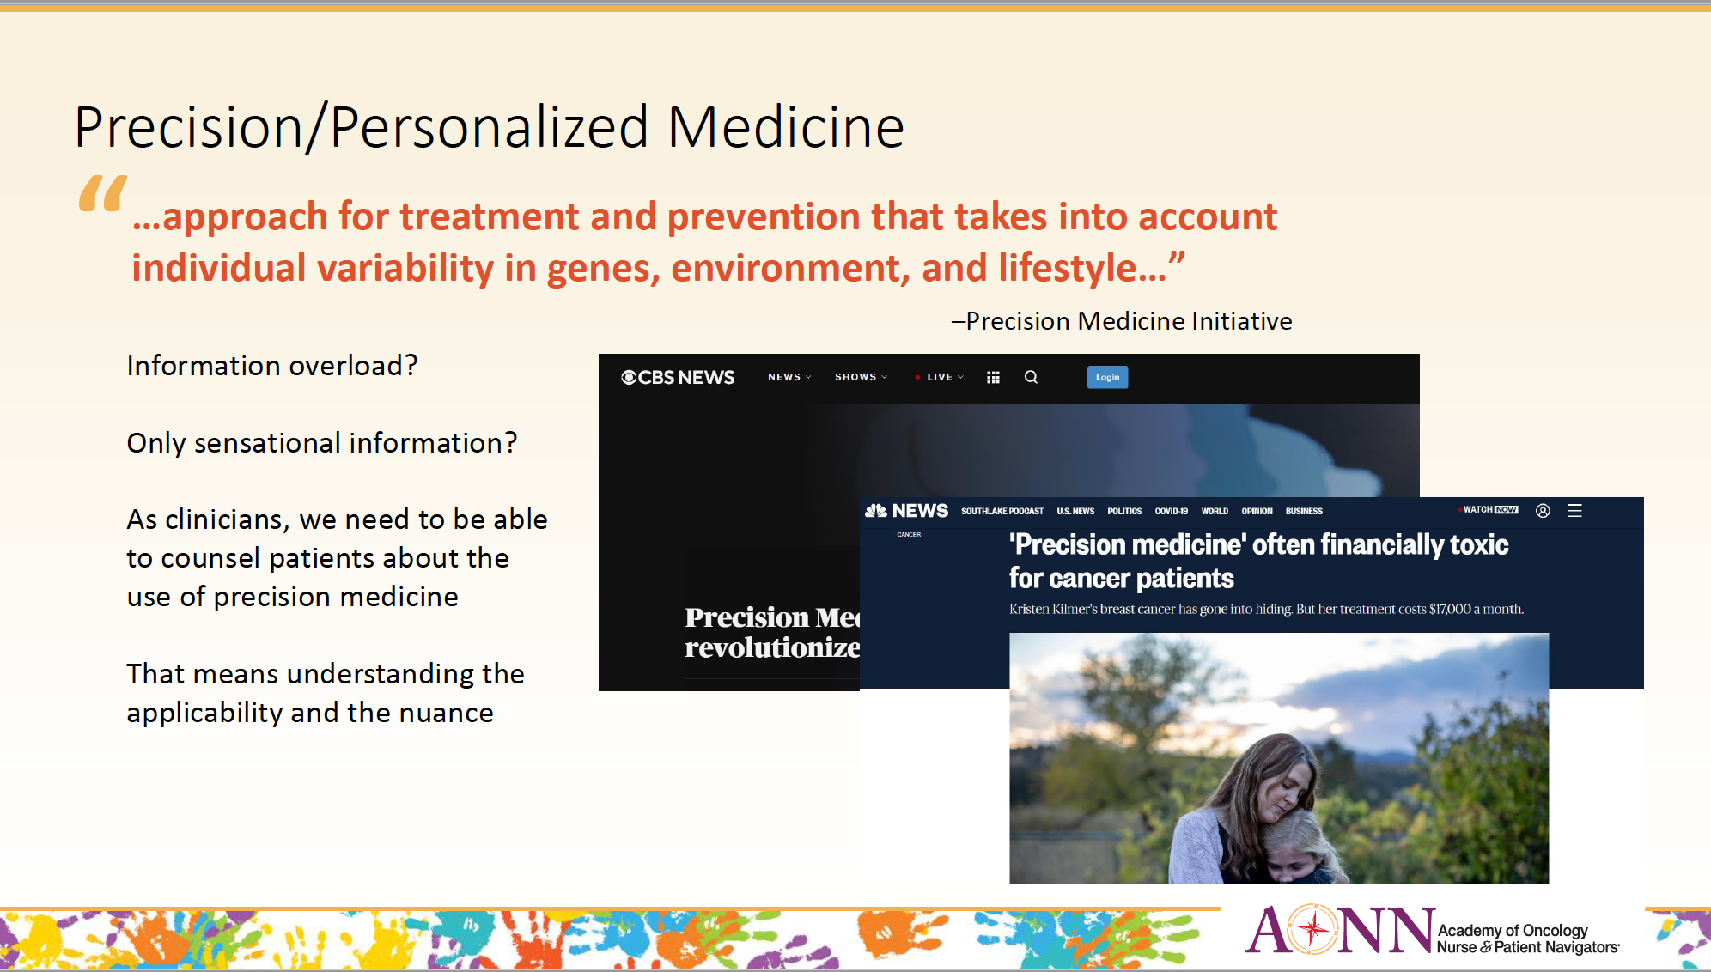
Notes:
Terms that often come up in the media
- patients find this info and wonder, what does it mean for them?
- genetics, genomics, biomarkers, precision medicine = can be very confusing words for patients, caregivers, and also physicians, HCP, and navigators in general

Slide 3
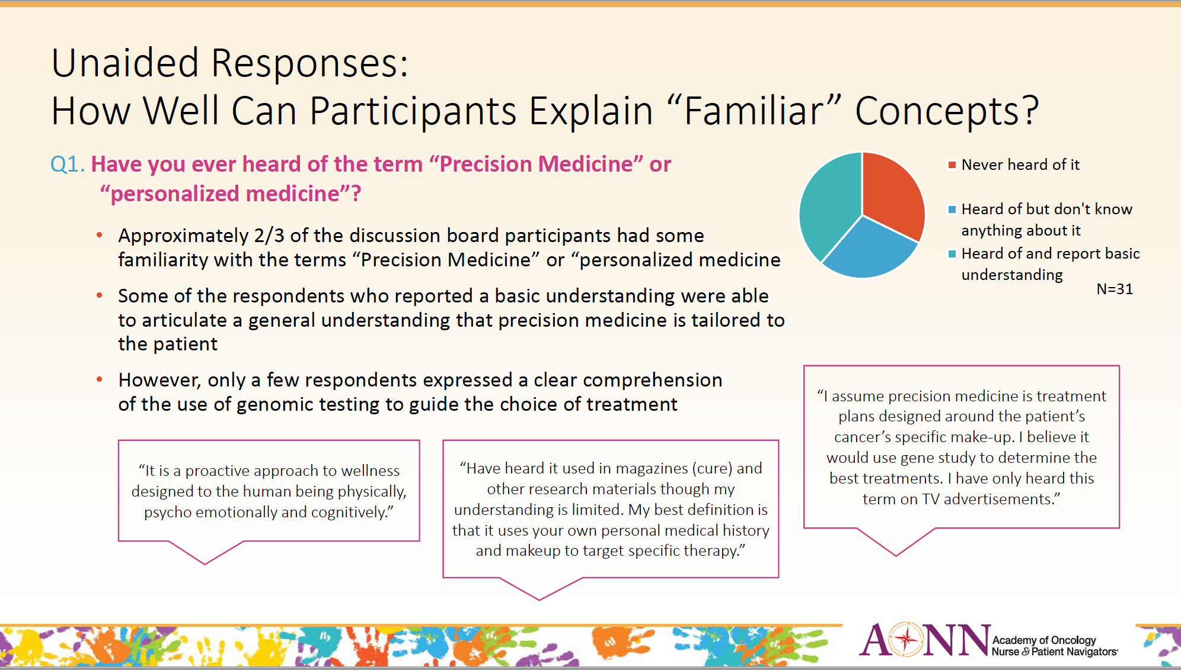
Precision Medicine Plain Language Lexicon available at:
www.CancerSupportCommunity.org/PMPlainLanguage
Notes:
As precision medicine treatment options evolve, the complexity of what cancer patients and caregivers need to understand to be active members in their health care team has increased dramatically. Developing clear, consistent precision medicine terminology is critically important to ensure patients are making informed decisions and receiving optimal care. With this goal in mind, CSC worked with patients and caregivers to develop this Precision Medicine Plain Language Lexicon. We hope that this lexicon, and future iterations of it, will allow oncology professionals and patients speak in a common language, reducing confusion, streamlining communication, and improving patient and caregiver understanding of precision medicine. This lexicon was developed with support and input from oncology professionals and has been subject to iterative patient and caregiver testing. Inspired by the efforts of the Consistent Testing Terminology Working Group, which included dozens of patient advocacy groups, oncology professional organizations and industry representatives, this lexicon includes the terms established by this workgroup, defines them, as well as other important terms and concepts. Over 300 cancer patients and caregivers, as well as 300 members of the general public were surveyed to validate that the definitions were clear to the vast majority (81-90% overall and at least 71% of respondents reporting household income <$50k & education <Bachelor’s degree). This survey also ranked preference for terms to use when there were multiple options. Nearly all terms are written at an eighth-grade reading level or below, to ensure greater and wider understanding by the general public.

Slide 4
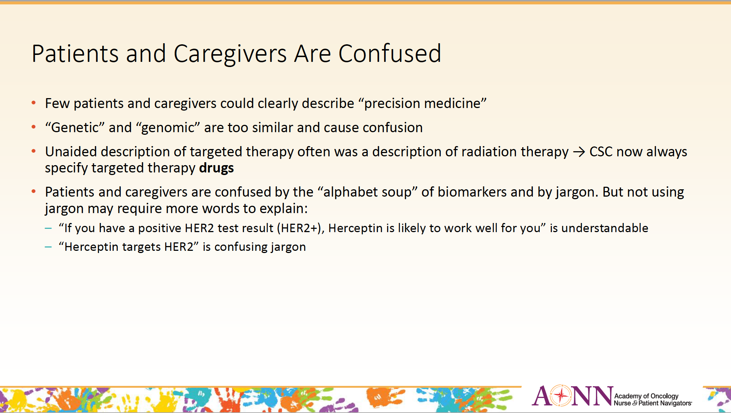
Cancer Support Community (2021)
Precision Medicine Plain Language Lexicon available at:
www.CancerSupportCommunity.org/PMPlainLanguage
Notes:
As precision medicine treatment options evolve, the complexity of what cancer patients and caregivers need to understand to be active members in their health care team has increased dramatically. Developing clear, consistent precision medicine terminology is critically important to ensure patients are making informed decisions and receiving optimal care. With this goal in mind, CSC worked with patients and caregivers to develop this Precision Medicine Plain Language Lexicon. We hope that this lexicon, and future iterations of it, will allow oncology professionals and patients speak in a common language, reducing confusion, streamlining communication, and improving patient and caregiver understanding of precision medicine. This lexicon was developed with support and input from oncology professionals and has been subject to iterative patient and caregiver testing. Inspired by the efforts of the Consistent Testing Terminology Working Group, which included dozens of patient advocacy groups, oncology professional organizations and industry representatives, this lexicon includes the terms established by this workgroup, defines them, as well as other important terms and concepts. Over 300 cancer patients and caregivers, as well as 300 members of the general public were surveyed to validate that the definitions were clear to the vast majority (81-90% overall and at least 71% of respondents reporting household income <$50k & education <Bachelor’s degree). This survey also ranked preference for terms to use when there were multiple options. Nearly all terms are written at an eighth-grade reading level or below, to ensure greater and wider understanding by the general public.

Slide 5
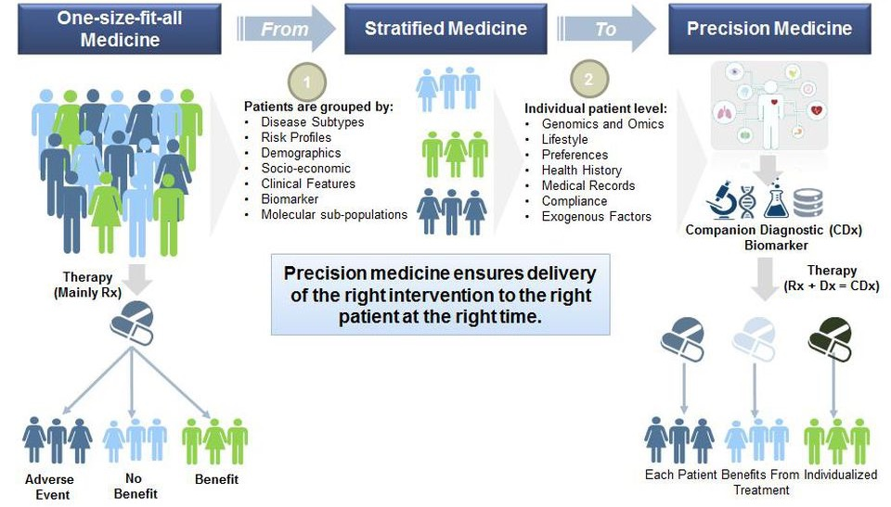
Paradigm Shift Away from “One-Size-Fits-All”
Treatment Options
Das R. Drug industry bets big on precision medicine: five trends shaping care delivery. Forbes. www.forbes.com/sites/reenitadas/2017/03/08/drug-development-industry-bets-big-on-precision-medicine-5-top-trends-shaping-future-care-delivery/#290bf7825d3a. Accessed November 29, 2018.
Notes:
history - dev't of precision medicine
FIND FIGHT and FOLLOW CANCERS

Slide 6
Blueprint
Review the basics of germline and somatic testing
Terminology in genetics, genomics, and precision medicine
Criteria for testing
Clinical implications of testing / case study (prostate cancer navigation)
Implications for oncology nurses
Collaboration with genetics professionals
Notes:
Last time – Genetics 101 – focused upon genetic/germline testing; so many new and emerging tech today (short period of time)

Slide 7
Objectives
Understand
Understand basic concepts of genetics & how they relate to cancer biology
Recognize
Recognize criteria for germline and tissue genetic testing (based upon NCCN)
Describe
Describe at least two interventions driven by genetics/genomics
Notes:
Learning objectives – measurables/deliverables
-hope all learn more
-hope you increase interest in genetics

Slide 8
Goals
Incorporate a genetic focus into your daily practice
With this improved understanding, allow you to provide ongoing support and management to patients and families
Genetic-related health concerns
Cancer treatment influenced by
genetic information
Identifying resources for practice
Notes:
We usually think about genetics as just genetic tests in healthcare
-so many ways genetics impacts care
-sometimes definitive, like a genetic/genomic test
-sometimes just inferred, perhaps a negative genetic test, to consider screening/prevention/nutrition
This is based upon what we know today about genetics
We’re learning more everyday (epigen, pharmacogenomics, etc.), and quickly – just a matter time before genetics/genomics routinely addressed throughout the care continuum
As nurses, (advocates/teachers/interpreters), our role has always been impt, not just to provide direct care, help pts understand what’s going on; given all the complexity & unknowns in genetics, the role is essential.

Slide 9
Why is genetics important to my practice?
Genetics research (HGP & others) has increased the knowledge base on genetics
  Possible to identify those at risk for cancer or other diseases
  Early diagnosis & health promotion
  Targeted treatment
  Increased understanding of progression of disease
Notes:
1 of 3 (technology)
Again, genetics potentially affects every step along the way, in oncology we are ahead of the curve…
- Including pre-conception/family planning

Slide 10
Why is genetics important to my practice?
Oncology nurses, as well as other HCP’s need to understand the implications of genetic knowledge for practice, education, research, and policy
  Nurses as educators
  Different ways to explain the same concept…”aha moment”
Notes:
2 of 3 (educator / knowledge)

Slide 11
Why is genetics important to my practice?
Basic understanding of science & Ethical, Legal, and Social Implications (ELSI)
Addressing barriers (1° knowledge)
  Providing a resource to others (patient, families, colleagues…)
Notes:
3 of 3 (big picture / ELSI)
- consider KNOWLEDGE BARRIER for navigated patients
- confusion...

Slide 12
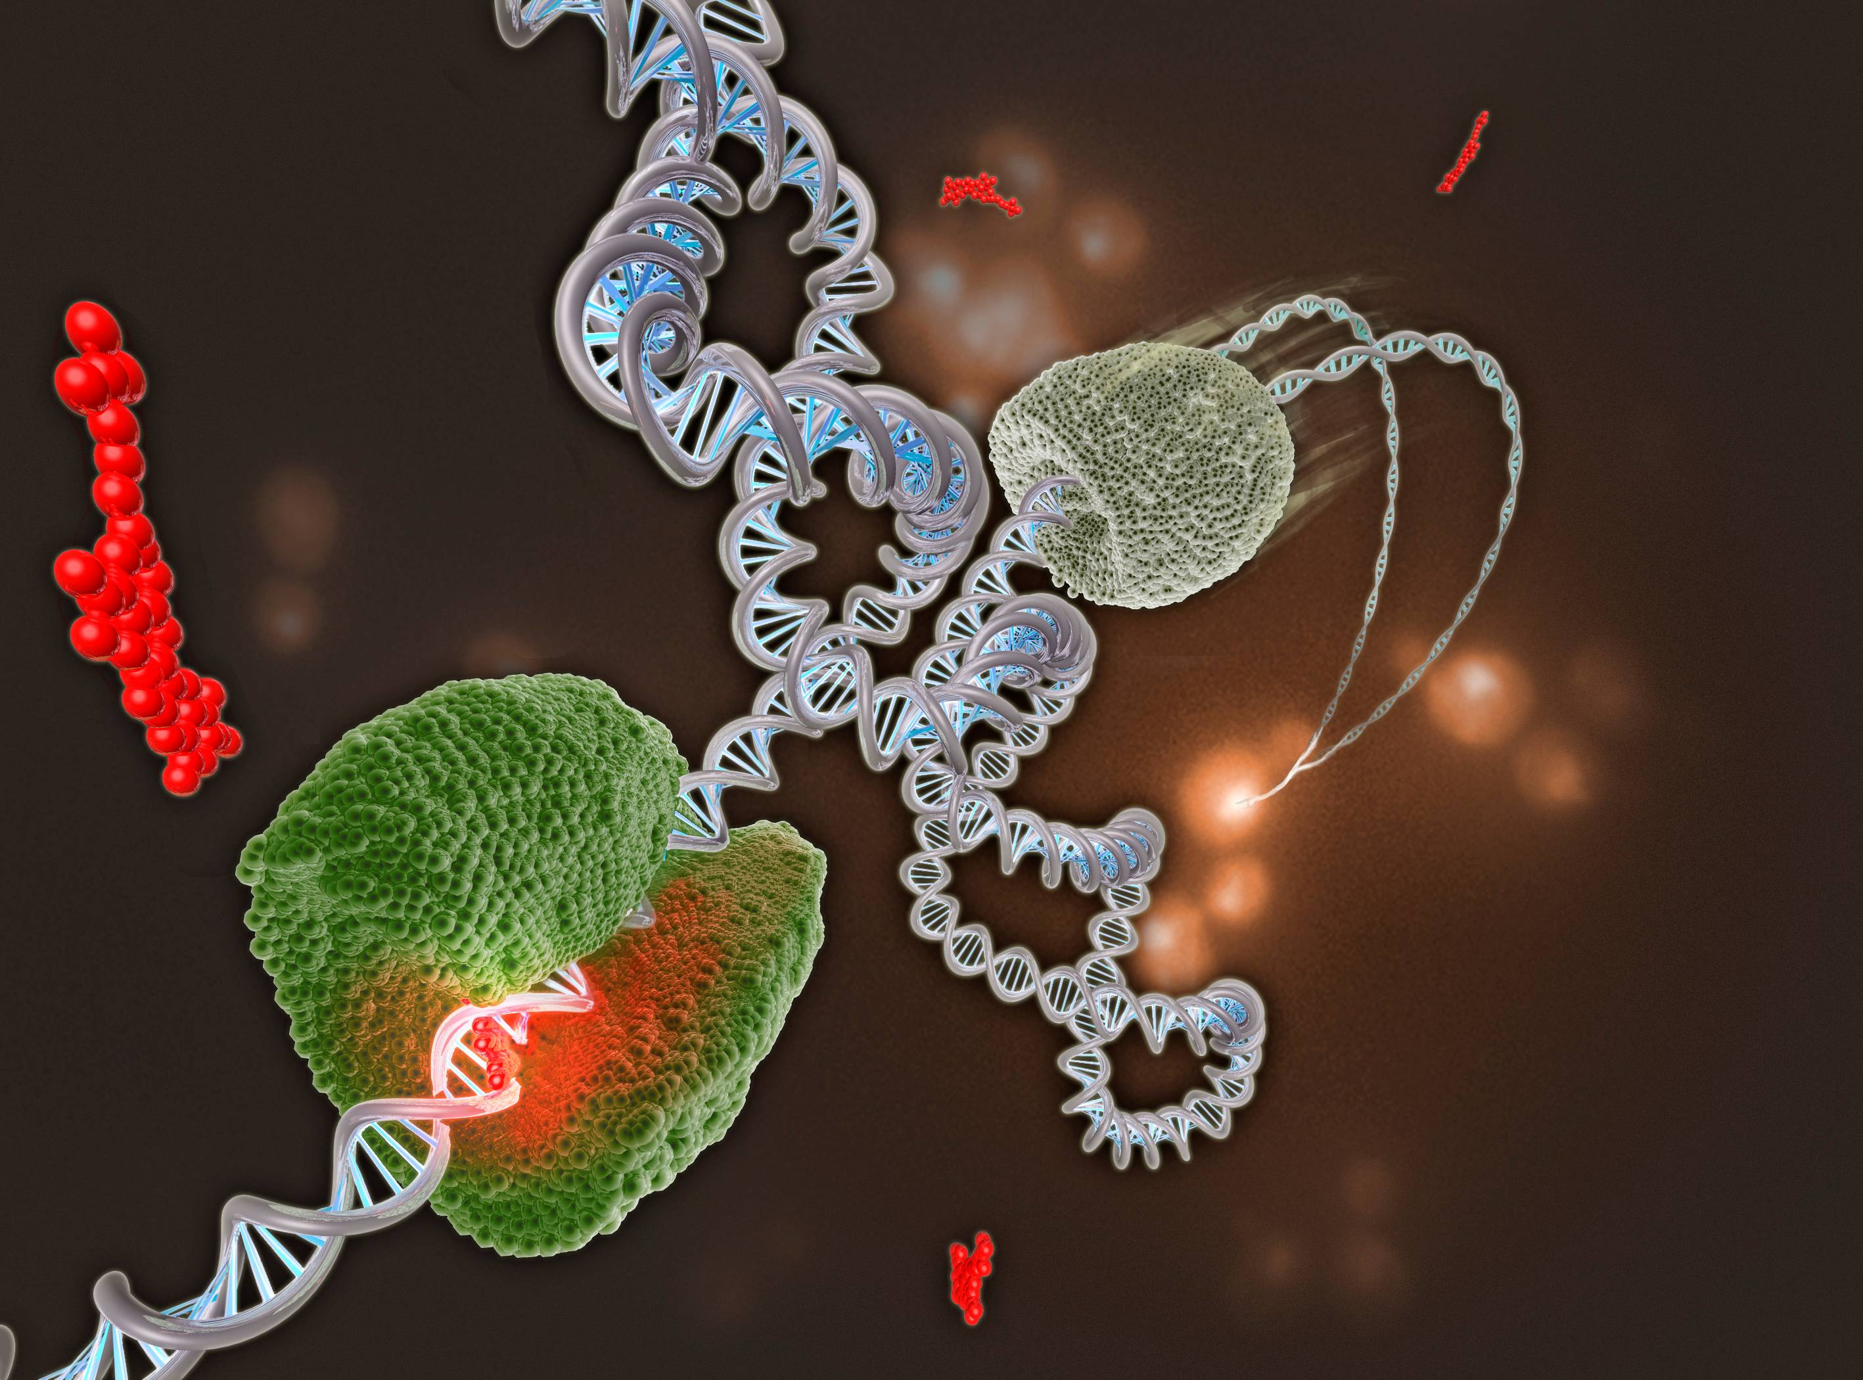
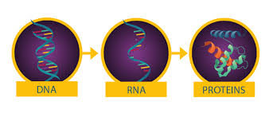
Genetics 101

Slide 13
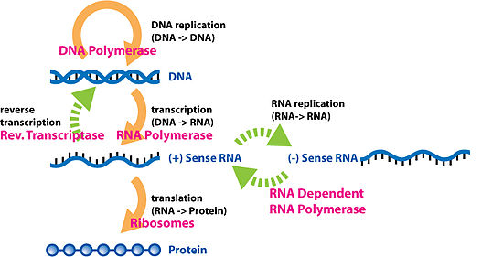
Central Dogma of Molecular Biology
DNA Replication
Transcription
Translation
Notes:
The central dogma of molecular biology is a fundamental principle that describes how genetic information flows within a biological system. It can be summarized as follows:
DNA Replication: The process by which DNA makes an identical copy of itself. This occurs before cell division, ensuring that each new cell receives a complete set of genetic instructions.
Transcription: In this step, the genetic information encoded in DNA is copied into a molecule called messenger RNA (mRNA). This process occurs in the cell nucleus and is mediated by enzymes called RNA polymerases.
Translation: The mRNA produced in transcription carries the genetic code from the nucleus to the ribosomes in the cytoplasm. At the ribosomes, the genetic information is translated into a specific sequence of amino acids, forming a protein molecule.
In essence, the central dogma states that genetic information flows from DNA to RNA to protein, and this flow of information is unidirectional and fundamental to the functioning of living organisms.
Special transfers of biological sequential information[edit]
Reverse transcription[edit]
Unusual flows of information highlighted in greenMain article: Reverse transcription
Reverse transcription is the transfer of information from RNA to DNA (the reverse of normal transcription). This is known to occur in the case of retroviruses, such as HIV, as well as in eukaryotes, in the case of retrotransposons and telomere synthesis. It is the process by which genetic information from RNA gets transcribed into new DNA. The family of enzymes involved in this process is called Reverse Transcriptase.
RNA replication[edit]
Main article: RNA-dependent RNA polymerase
RNA replication is the copying of one RNA to another. Many viruses replicate this way. The enzymes that copy RNA to new RNA, called RNA-dependent RNA polymerases, are also found in many eukaryotes where they are involved in RNA silencing.^{[11]}
RNA editing, in which an RNA sequence is altered by a complex of proteins and a "guide RNA", could also be seen as an RNA-to-RNA transfer.
Direct translation from DNA to protein[edit]
Direct translation from DNA to protein has been demonstrated in a cell-free system (i.e. in a test tube), using extracts from E. coli that contained ribosomes, but not intact cells. These cell fragments could synthesize proteins from single-stranded DNA templates isolated from other organisms (e.g., mouse or toad), and neomycin was found to enhance this effect. However, it was unclear whether this mechanism of translation corresponded specifically to the genetic code.^{[12][13]}
https://en.wikipedia.org/wiki/Central_dogma_of_molecular_biology
Reverse transcription is a molecular process in which RNA is converted back into DNA. This process is catalyzed by an enzyme called reverse transcriptase. Reverse transcription is a key step in the life cycle of retroviruses, such as HIV, as well as in the replication of retrotransposons, a type of genetic element that can move around within a genome.
In the context of molecular biology research, reverse transcription is commonly used to generate complementary DNA (cDNA) from RNA templates. This cDNA can then be amplified by techniques such as polymerase chain reaction (PCR) and analyzed further. Reverse transcription followed by PCR is a powerful tool for studying gene expression, as it allows researchers to measure the levels of specific RNA molecules present in a sample. It is widely used in fields such as molecular biology, genetics, and biotechnology.

Slide 14
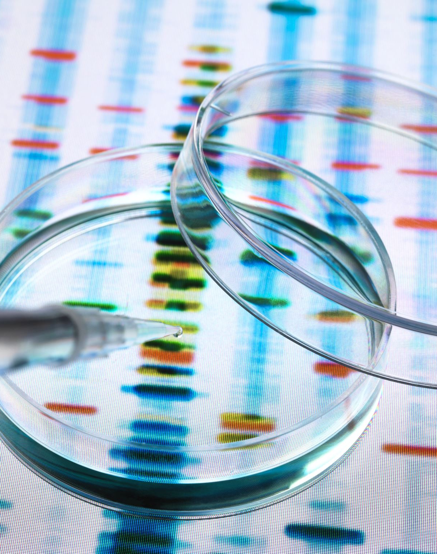
Genetics expanded to “omics”
Genomics
Transcriptomics
Proteomics
Metabolomics
Epigenomics
Pharmacogenomics
Notes:
"Omics" is a term used to describe fields of study that focus on large-scale analysis of biological molecules or systems. In genetics, several "omics" disciplines have emerged, each focusing on a different aspect of genetic information. Here are some of the key "omics" related to genetics:
Genomics: The study of an organism's entire genome, including the sequencing and analysis of its DNA.
Transcriptomics: The study of all the RNA transcripts produced by the genome under specific conditions or in specific tissues. It involves analyzing gene expression patterns and regulation.
Proteomics: The study of all the proteins produced by the genome under specific conditions or in specific tissues. It involves analyzing protein structures, functions, interactions, and expression levels.
Metabolomics: The study of all the small molecules (metabolites) produced by cellular processes. It involves analyzing metabolic pathways, metabolite concentrations, and metabolic changes in response to various factors.
Epigenomics: The study of chemical modifications to DNA and histone proteins that can influence gene expression without changing the underlying DNA sequence. It involves analyzing epigenetic marks such as DNA methylation and histone acetylation.
Pharmacogenomics: The study of how genetic variations affect an individual's response to drugs. It involves analyzing genetic factors that influence drug metabolism, efficacy, and adverse reactions.
Metagenomics: The study of genetic material recovered directly from environmental samples, such as soil, water, or the human gut microbiome. It involves analyzing the collective genomes of microbial communities.

Slide 15
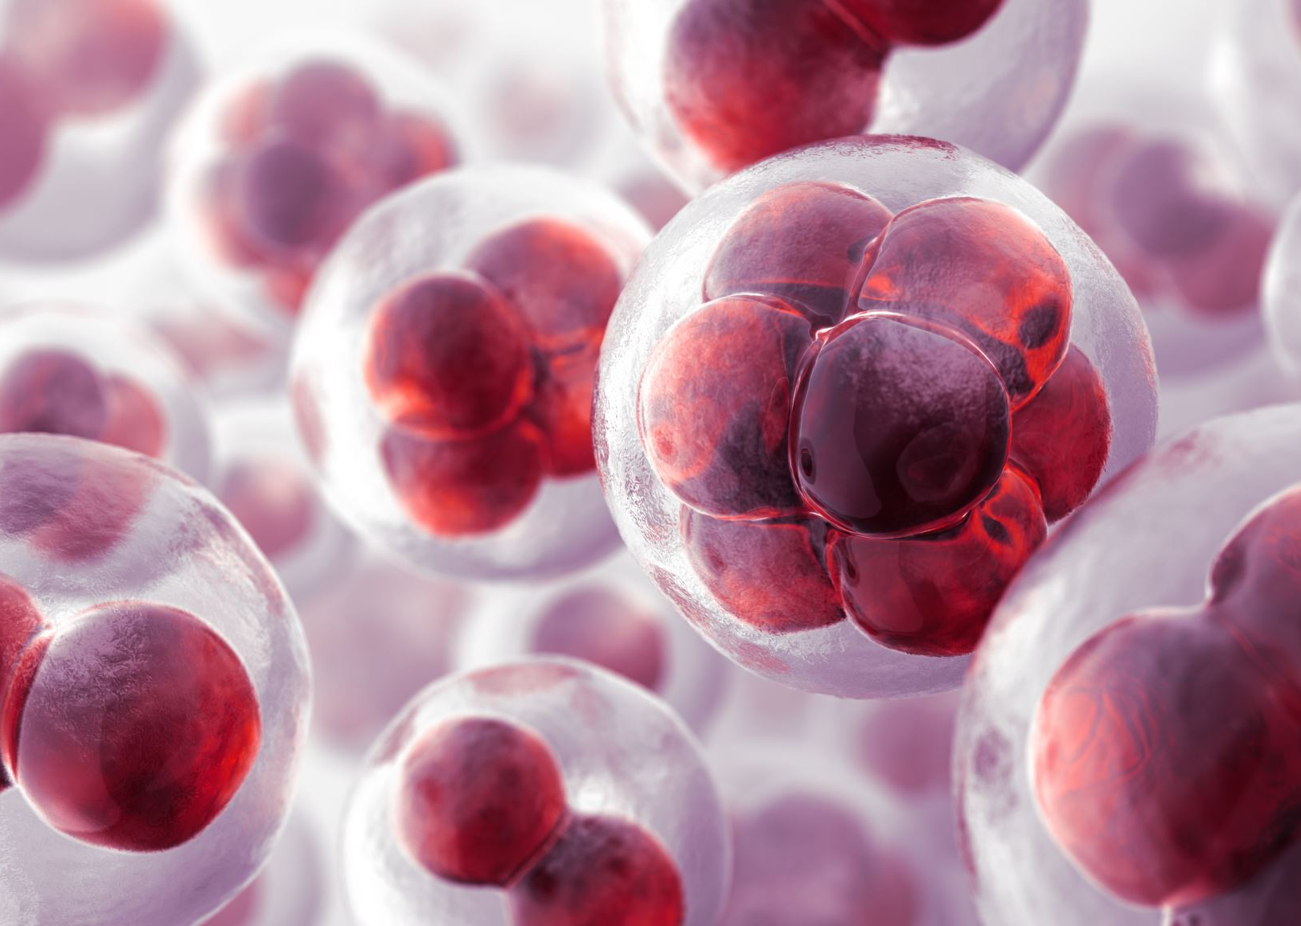
The Genetics of Cancer
Notes:
That was genetics in general – where we’ve been, where we are today
Still plenty of potential.
Genetics of disease … Genetics of Cancer
Oncology – genetics knowledge is enough where it can be clinically relevant – even used to make clinical decisions
(vs. Cardio, Neuro)
http://www.cancer.net/all-about-cancer/genetics/genetics-cancer

Slide 16

Genetics of Cancer 1
DNA replication very complex = amazing how we don’t have more mistakes
BRCA example = Tumor Suppressor Gene
  “Proofreader”
DNA replication
“mistakes”
Accumulation of mistakes can lead to loss of instructions for a cell to stop dividing
Notes:
How Genetic Changes Lead to Cancer
Genes contain information to make proteins, and proteins control many important functions like cell growth. Genetic mutations can change how proteins function. Some types of genetic mutations change proteins in ways that cause healthy cells to become cancerous.
The Genetics of Cancer
This section has been reviewed and approved by the Cancer.Net Editorial Board, 08/06
CANCER is by nature a genetic disease. Our cells are constantly dividing/duplicating. Genetic material / DNA is copied in the process, but mistakes happen. When a cell accumulates enough mistakes/mutations/variants, it may forget how to stop dividing.
We now know that many of the genes we're born with, are responsible in some way, to help prevent or even correct those mistakes (BRCA, Lynch).
There are basically two types of genetic mutations that come into play...
How genes cause cancerFor various reasons, genes often undergo mutations (changes). Some mutations have no effect on a cell, while other mutations are harmful or helpful to the cell. There are two basic kinds of genetic mutations. If the mutation is passed from one of the parents to the child, it is called a germline mutation. When a germline mutation is passed on from a parent to the child, it is present in every cell of the child's body, including the reproductive sperm and egg cells. Because the mutation affects reproductive cells, it is passed from generation to generation. Germline mutations are responsible for 5% to 10% of cancer cases. This is also called familial (occurring in families) cancer.Most cancers are caused by a series of mutations that develop during a person's lifetime called acquired mutations. Acquired mutations are caused by tobacco, over-exposure to UV radiation, and other toxins and chemicals. These mutations are not in every cell of the body and are not passed from parent to child. Cancer caused by this type of mutation is called sporadic cancer.Most scientists believe that cancer happens when several genes of a particular group of cells become mutated. Some people may have more inherited mutations than others, and even with the same amount of environmental exposure, some people are simply more likely to develop cancer.Genes that play a role in cancerThe following types of genes contribute to cancer:Tumor suppressor genes. These are protective genes. Normally, they suppress (limit) cell growth by monitoring the rate at which cells divide, repairing mismatched DNA, and controlling cell death. When a tumor suppressor gene is mutated (due to heredity or environmental factors), cells continue to grow and can eventually form a tumor. Close to 30 tumor suppressor genes have already been identified, including BRCA1, BRCA2, and p53. In fact, nearly 50% of all cancers involve a missing or damaged p53 gene.Oncogenes. These genes turn a healthy cell into a cancerous one. HER2/neu and ras are two common oncogenes.DNA repair genes. These are genes that fix any mistakes made when DNA is replicated (copied). Mistakes that aren't fixed become mutations, which may eventually lead to cancer, especially if the mutation occurs in a tumor suppressor gene or oncogene.Cancer develops when several genes in a cell become mutated in a way that overrides the checks and balances of the cell. However, many cancers cannot be tied to a specific gene, and some genes may interact in unpredictable ways with other genes or factors in the environment to cause cancer. In the future, doctors hope to learn more about the role of genetic changes in the development of cancer, which may lead to improved cancer treatment and prevention strategies.

Slide 17


Let’s Review–What Is the Difference Between Germline and Somatic Testing?
Parent
Child
Heritable
Nonheritable
GERMLINE MUTATION¹
SOMATIC MUTATION^{2,3}
A germline mutation is a change in a gene that was inherited and, therefore, causes an increased risk for cancer
This is also known as hereditary cancer
Only approximately 5%-10% of cancer is hereditary
Most cancers have many somatic mutations²
A somatic mutation is a change in a gene that can lead to the development of cancer²
Can sometimes identify hereditary predisposition
1. National Cancer Institute. The Genetics of Cancer. www.cancer.gov/about-cancer/causes-prevention/genetics. Accessed December 5, 2018.
2. Martincorena I, Campbell PJ. Somatic mutation in cancer and normal cells. Science. 2015;349(6255):1483-1489.
3. Cancer.net. The Genetics of Cancer. www.cancer.net/navigating-cancercare/cancer-basics/genetics/genetics-cancer. Accessed December 7, 2018.
Notes:
An important context for the impact of genetics/genomics in cancer care is that we are dealing with two sets of genomic variants – those that we were born with and that exist in every cell of our body (germline) and those that specific cells have acquired during our lifetimes through a variety of mechanisms, including damage from the environment (somatic). Somatic changes are present in cancer cells but not in other cells of the body.
Somatic variants cannot be passed on or inherited; germline variants can be.
Germline = heritable, present in the sex cells
Somatic = acquired, present in the tumor cells only
Both types may impact cancer development and progression
____Germline mutations –mutation in reproductive cell (egg or sperm) that is transmitted to every cell in offspring
•Referred to as “hereditary” or “inherited”
•Usually detected in blood/saliva
•Can be detected in healthy people = cancer predisposition
Somatic mutations –occurs AFTER conception
•In cancers, usually occurs in the tumor cells
•Cells that are derived from cells with the mutation also have the mutation

Slide 18
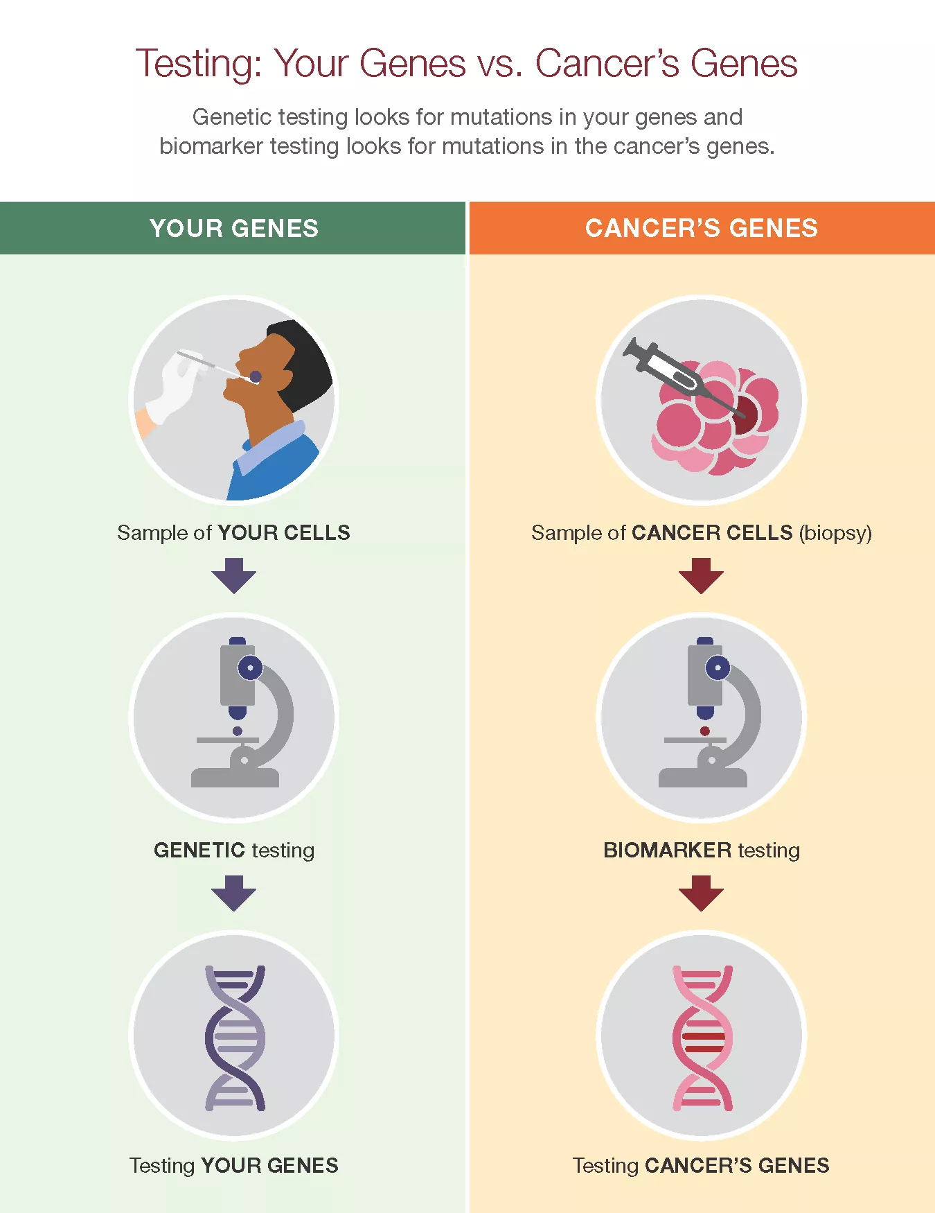
What Is the Difference Between Germline and Somatic Testing?

Slide 19
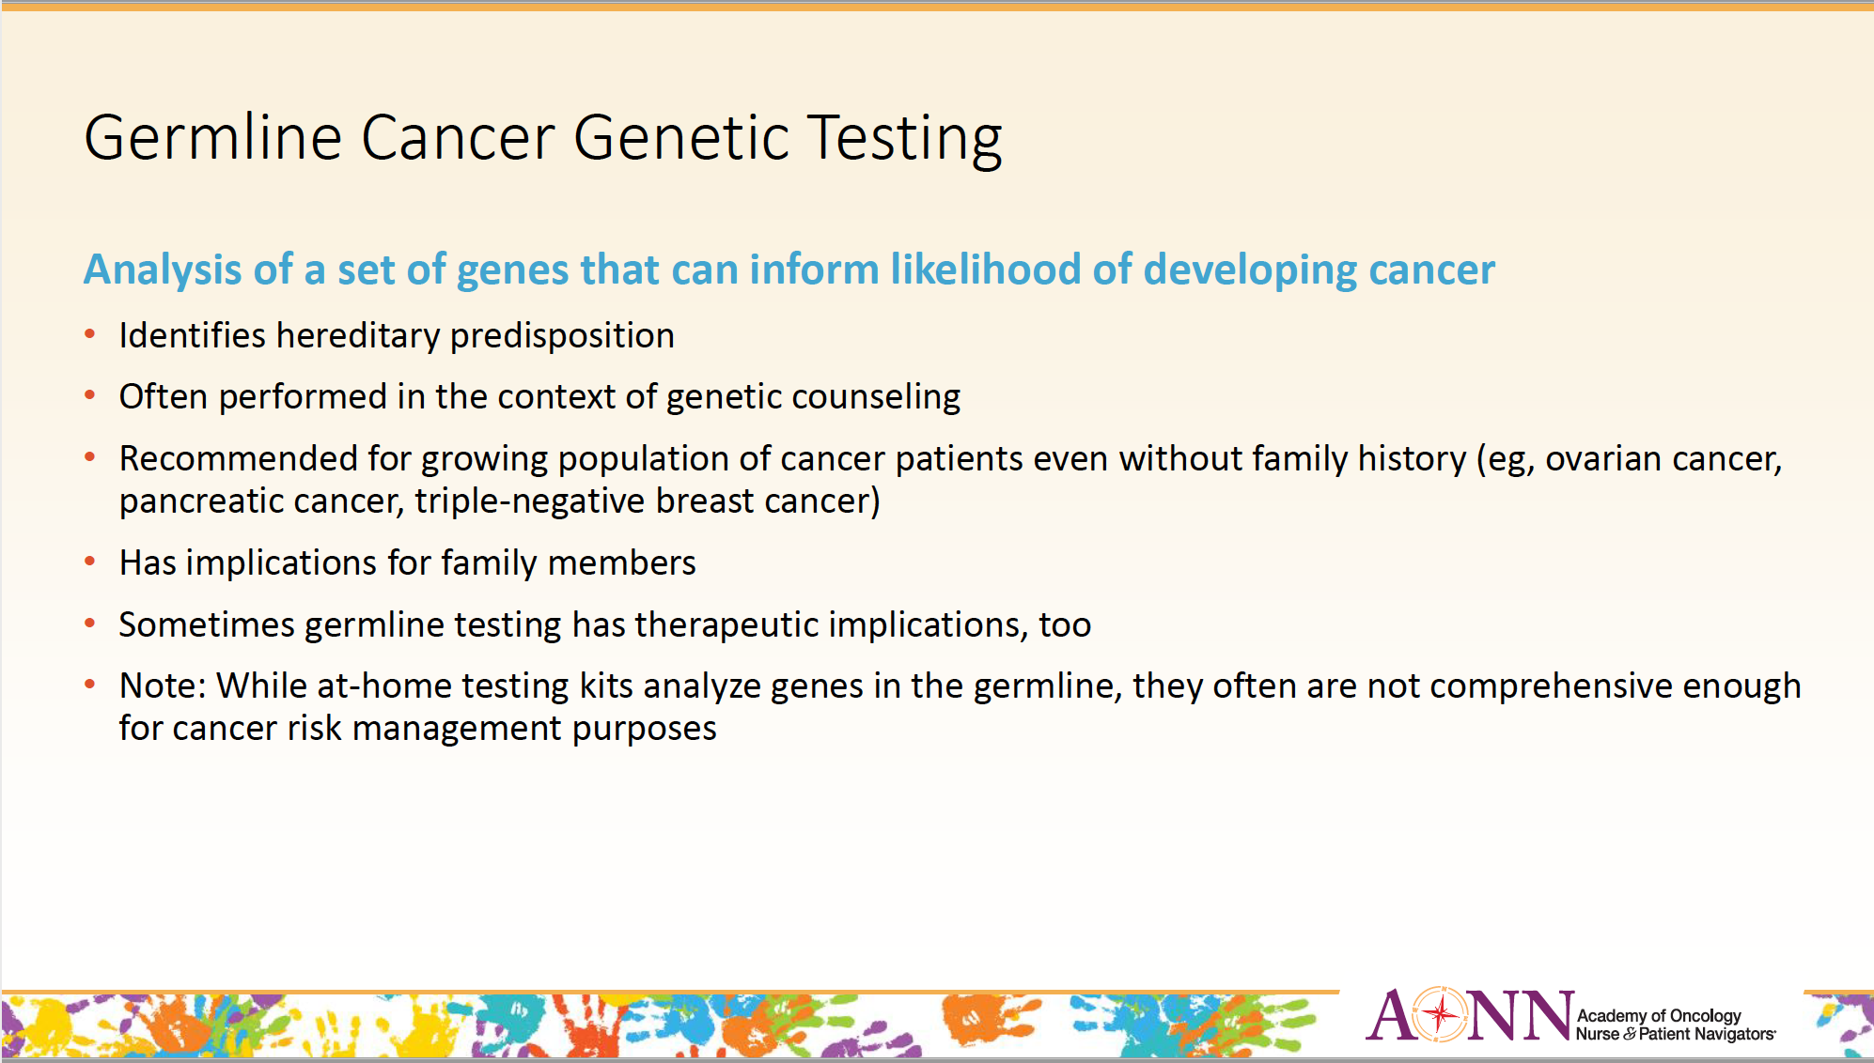
Preferred terminology: Genetic Testing for Inherited Risk
Notes:
Ref: Leigha Senter-Jamieson, MS, CGC
Blurred Lines Between Germline and Somatic Testing for Precision Medicine JONS
June 2022 Vol 13, No 6

Slide 20
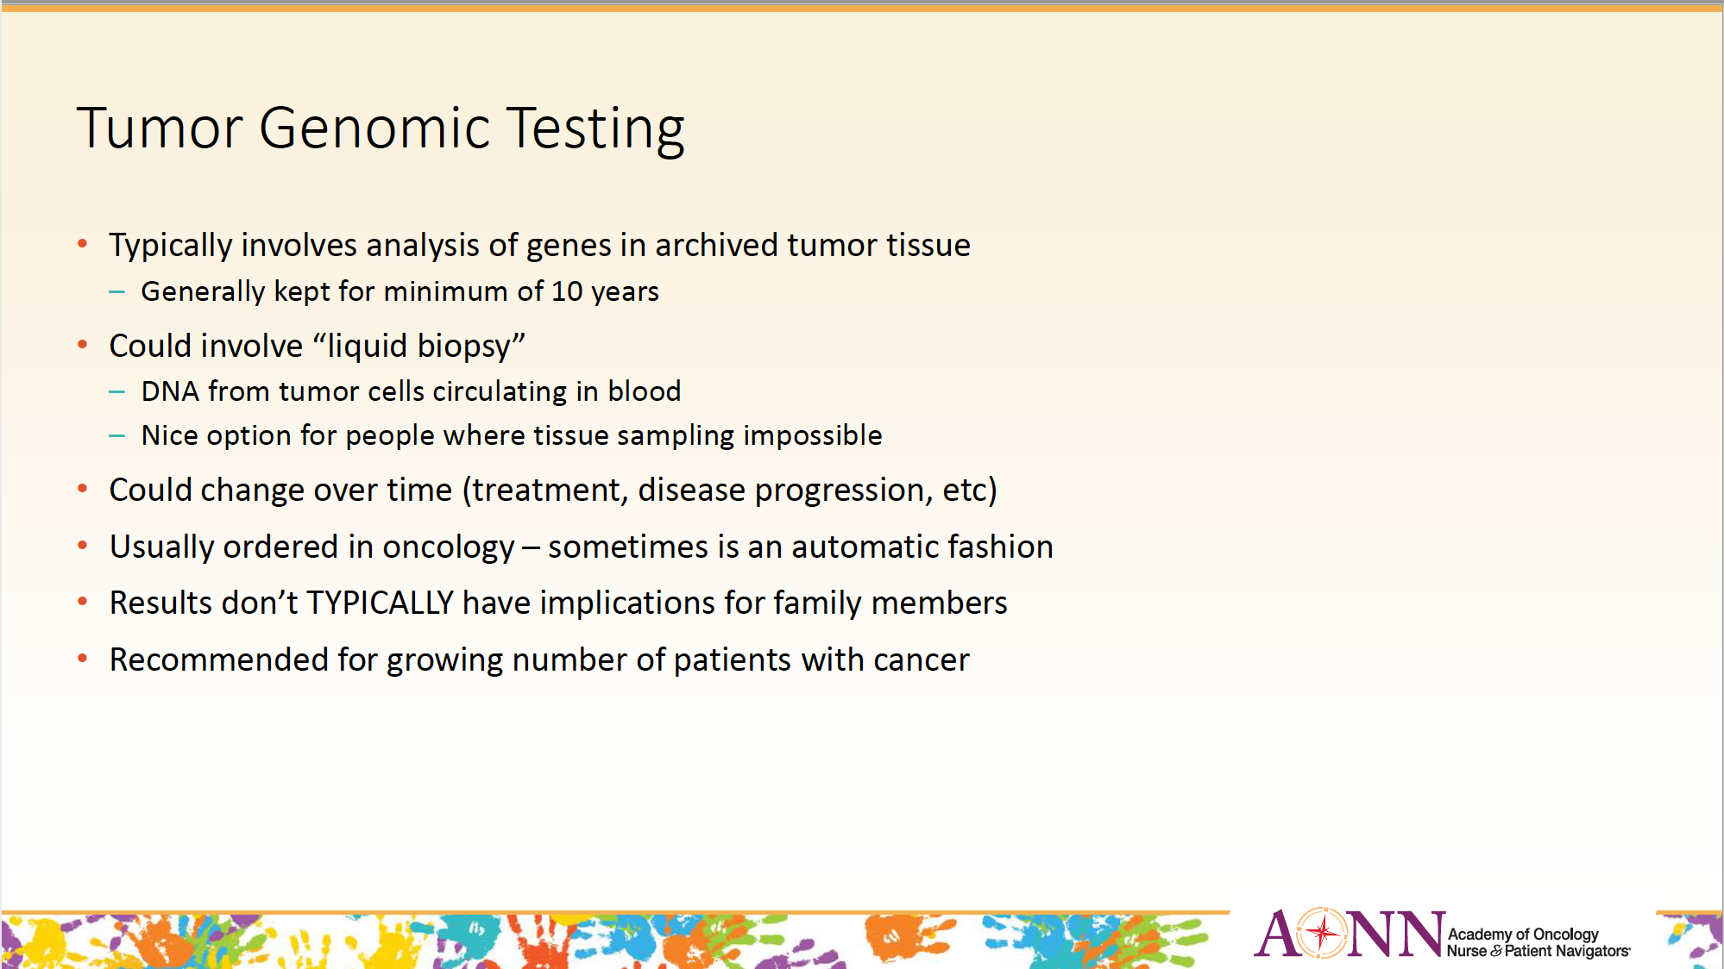
Preferred terminology: Tissue biomarker testing

Slide 21
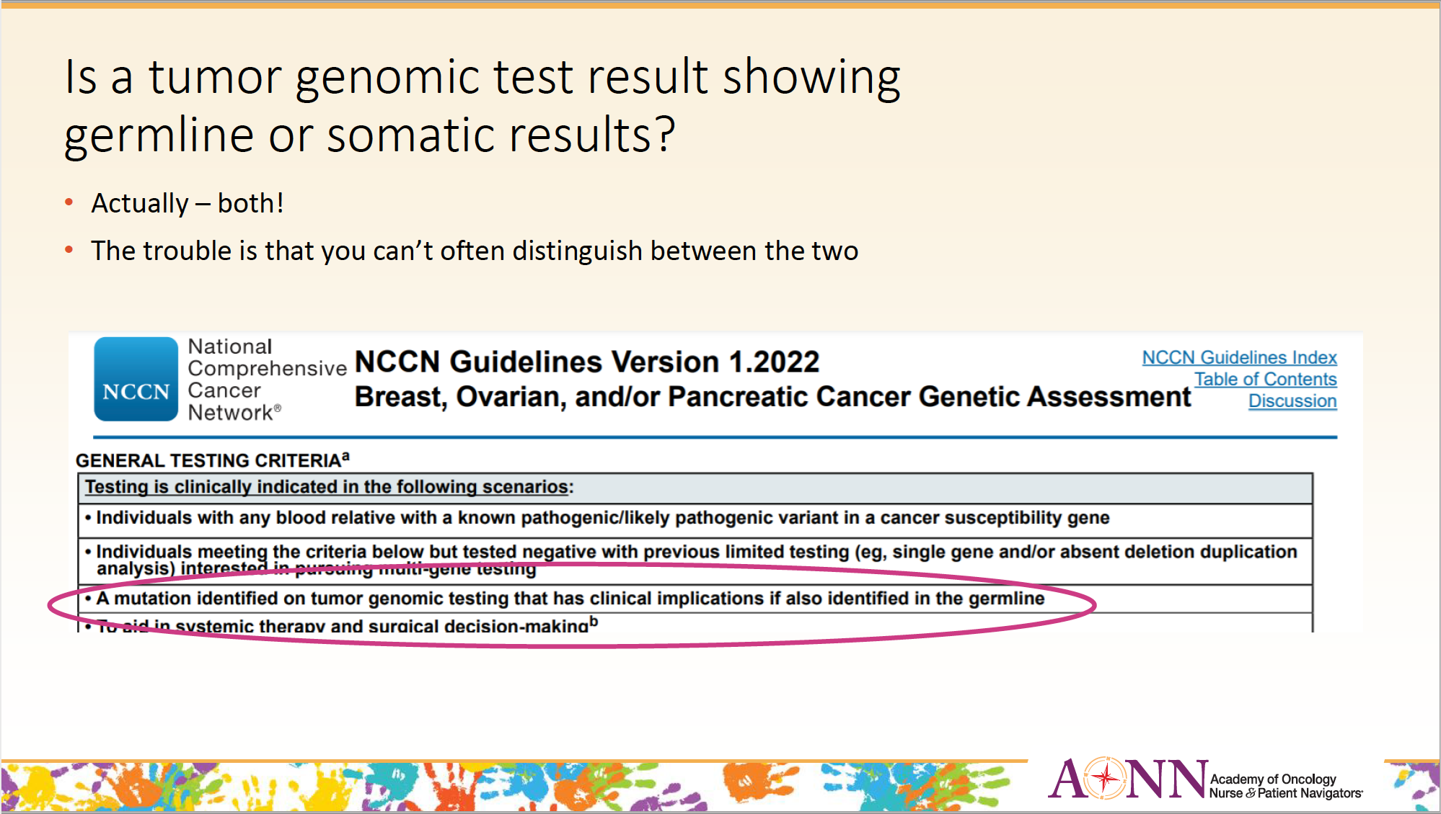
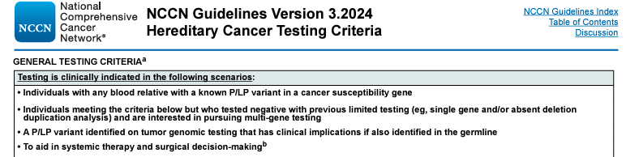

Slide 22
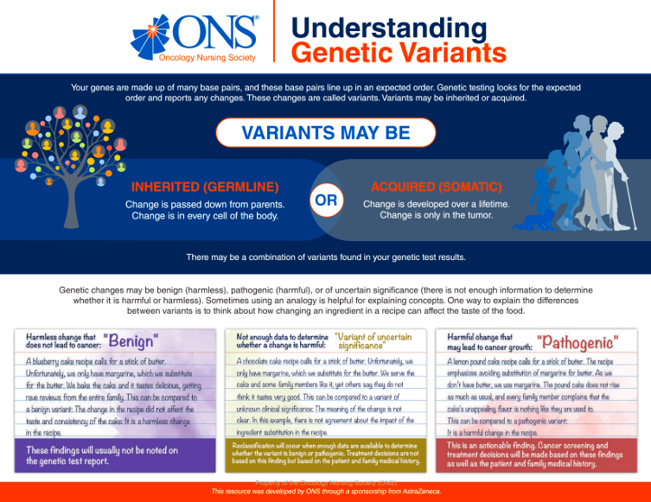

Slide 23

Prostate Cancer Patient, Mr. E.
68 year old
PSA 5.6
T1c Nx Mx
Gleason 3+4 (Grade Group 2)
Has two daughters
Family history of breast cancer in his sister

Slide 24

Case Study / Prostate Cancer Navigation:
  NCCN Favorable Intermediate Risk
  Active Surveillance
  Surgery
  Radiation
  What genetic OR genomic tests are available to him?
Notes:
FRANK
Examples of tissue & germline impacting patient/family

Slide 25
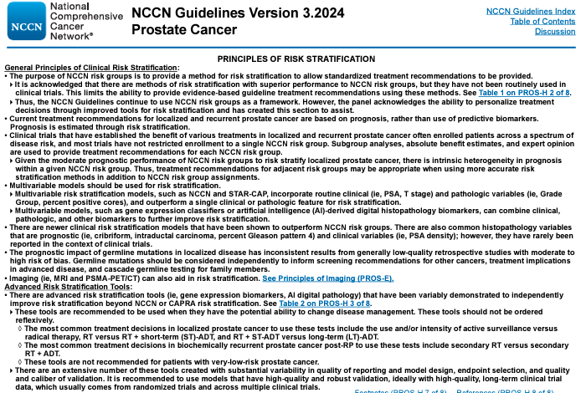
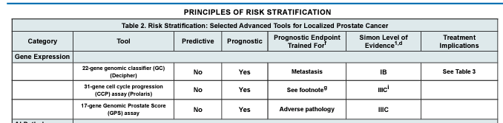
Risk Stratification: Gene Expression Studies
Notes:
A prostate cancer gene expression study is a research investigation that focuses on analyzing the activity levels of genes in prostate cancer cells. Gene expression refers to the process by which information encoded in genes is used to produce functional gene products, such as proteins or RNA molecules.
In a prostate cancer gene expression study, researchers typically compare the patterns of gene expression between prostate cancer cells and normal prostate cells. This comparison can help identify genes that are upregulated (expressed at higher levels) or downregulated (expressed at lower levels) in prostate cancer cells compared to normal cells. By identifying these genes, researchers can gain insights into the molecular mechanisms underlying prostate cancer development and progression.
Prostate cancer gene expression studies often use techniques such as microarray analysis or RNA sequencing to measure the expression levels of thousands of genes simultaneously. These studies may also involve the analysis of clinical data to correlate gene expression patterns with various clinical parameters, such as tumor stage, grade, or patient outcomes.
The findings of prostate cancer gene expression studies can have important implications for understanding the biology of prostate cancer, identifying potential diagnostic markers, predicting patient prognosis, and developing targeted therapies for the disease.

Slide 26
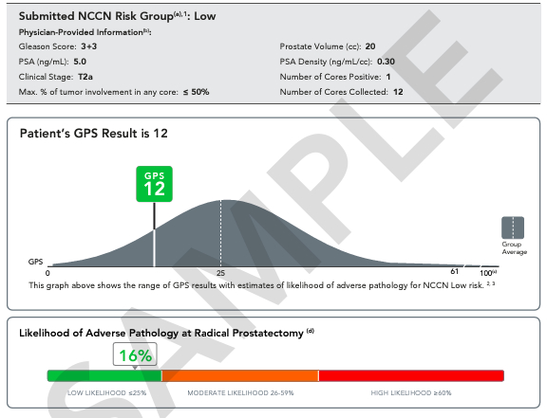
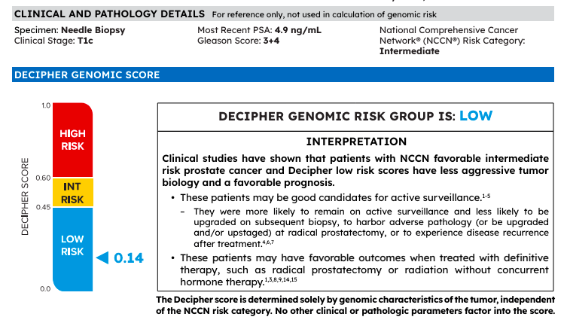

Slide 27
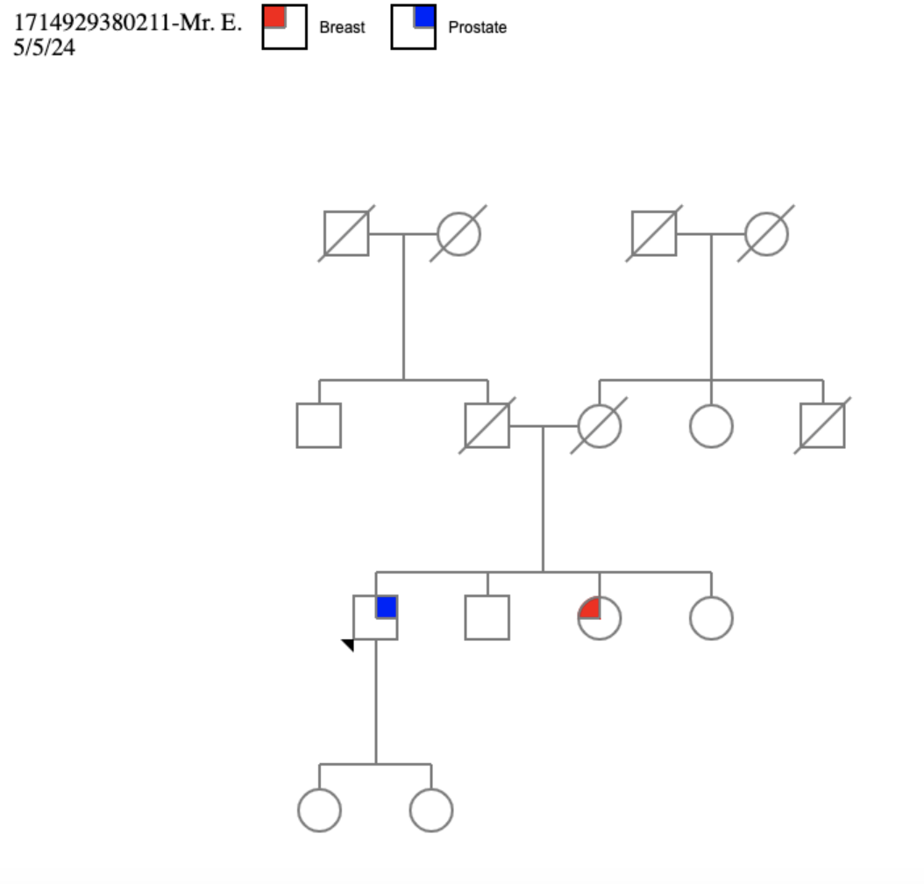
Prostate Cancer Patient, Mr. E.
Gene expression study of his prostate biopsy tissue showed HIGH risk disease
He decided to have surgery instead of active surveillance
Sister actually had breast cancer diagnosed at age 47 in 2007, did not have BRCA1/2 testing

Slide 28
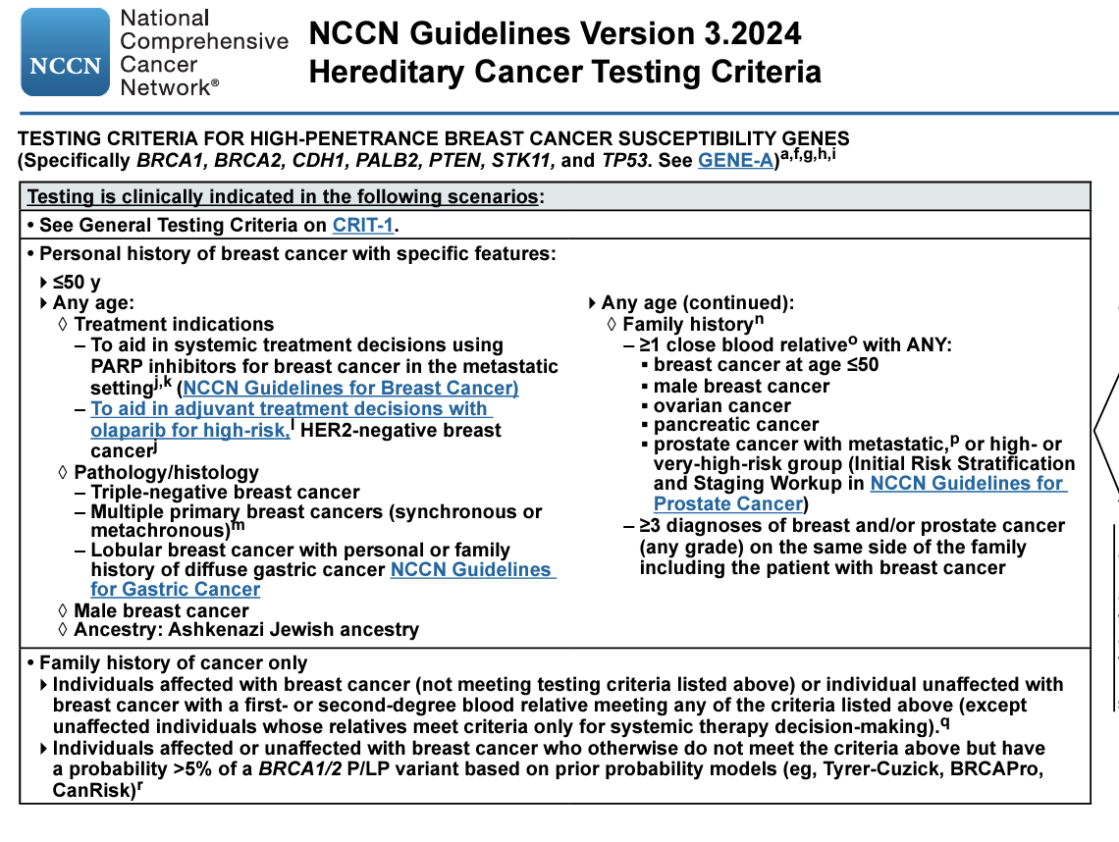
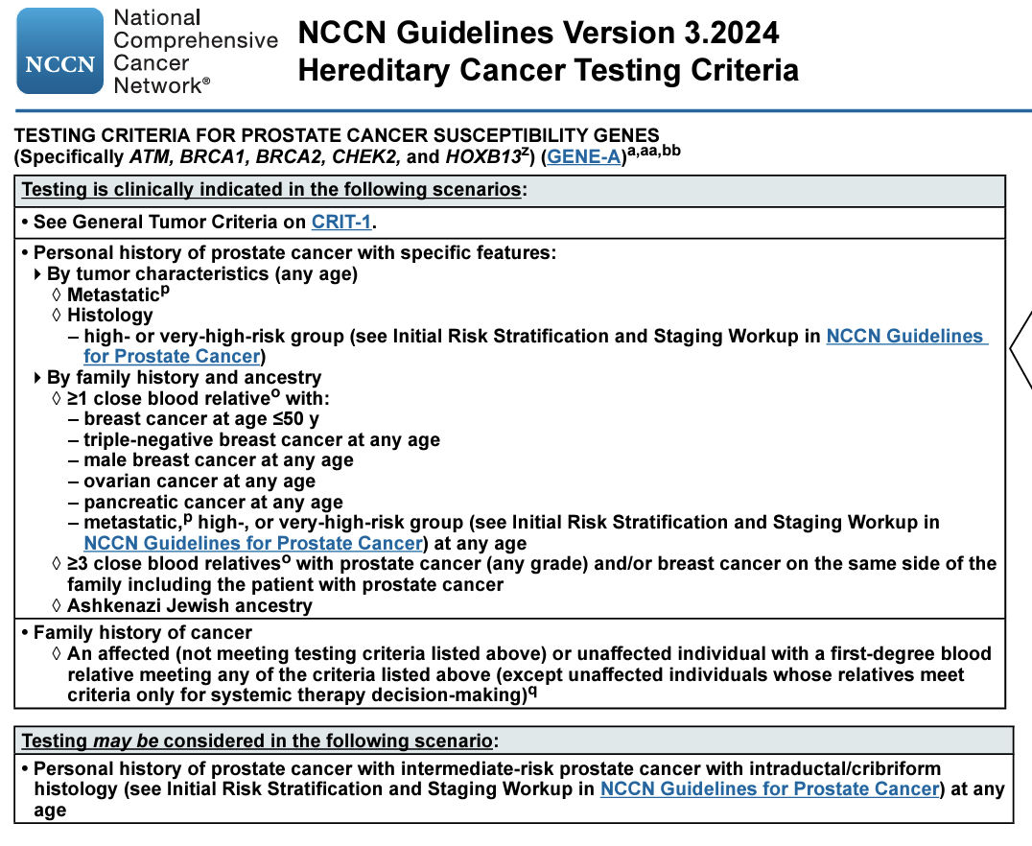
NCCN Germline Testing Criteria: Breast / Prostate

Slide 29
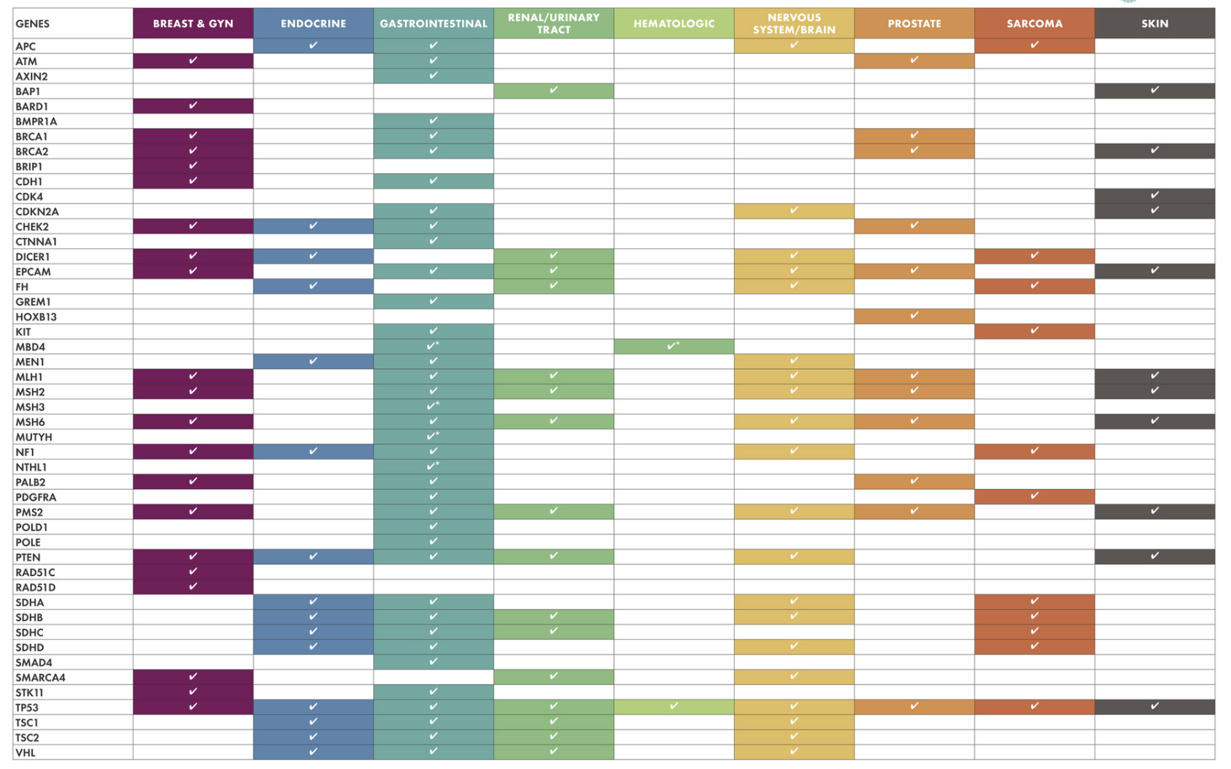
Notes:
Table 1
Medical factors influencing decision making regarding radiation therapy for breast cancer
Cardiovascular factors• Coronary artery disease• Implanted cardiac devicesPulmonary factors• Radiation pneumonitisConnective tissue disease factors• Rheumatoid arthritis• Mixed connective tissue disease• Systemic lupus erythematosus• Scleroderma• Psoriasis• VitiligoPrior radiation therapy• Prior breast radiation therapy and subsequent in-breast recurrence• High- and low-dose brachytherapy• External beam radiation therapy• Three-dimensional conformal external-beam radiation therapy• History of Hodgkin lymphomaGenetic factors• BRCA1/2 mutations• Li-Fraumeni syndrome• Cowden syndrome• Ataxia telangiectasia syndrome
https://www.ncbi.nlm.nih.gov/pmc/articles/PMC4242405/table/t1-ijwh-6-945/

Slide 30
Prostate Cancer Patient, Mr. E.
Sister had breast cancer diagnosed at age 47 in 2007, did not have BRCA1/2 testing
Mr.E was seen by genetic counseling and panel testing revealed at BRCA2 Pathogenic Variant
Cascade family testing arranged
Sister and one daughter tested BRCA2+

Slide 31

Case Study 2 / Recurrent Prostate Cancer, Mr. H.
  72 year-old male, initially diagnosed with prostate cancer, Gleason Score 4+3 (GG3), had prostatectomy
    Biochemical recurrence led to pelvic XRT
    PSA now at 0.9 ng/ml
    No family history of cancer
    PSMA scan ordered

Slide 32
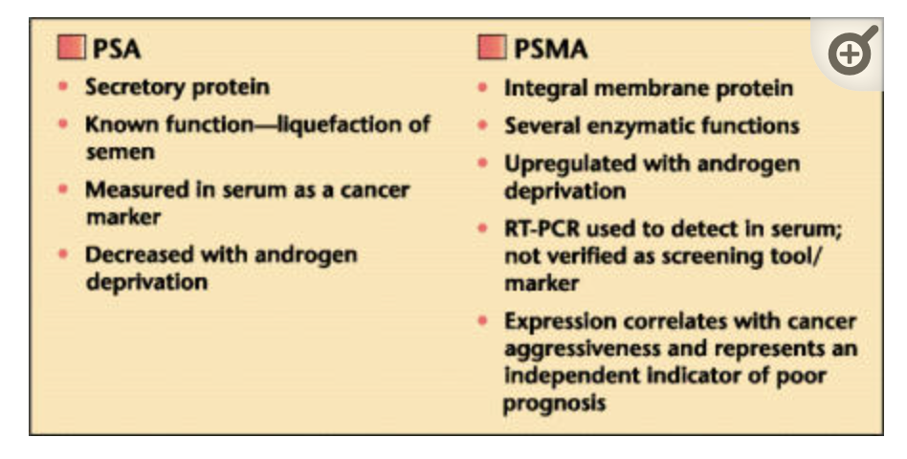
Radiopharmaceuticals: Prostate Specific Membrane Antigen (PSMA)
Diagnostic
Therapeutic
*It’s not the same as PSA

Slide 33
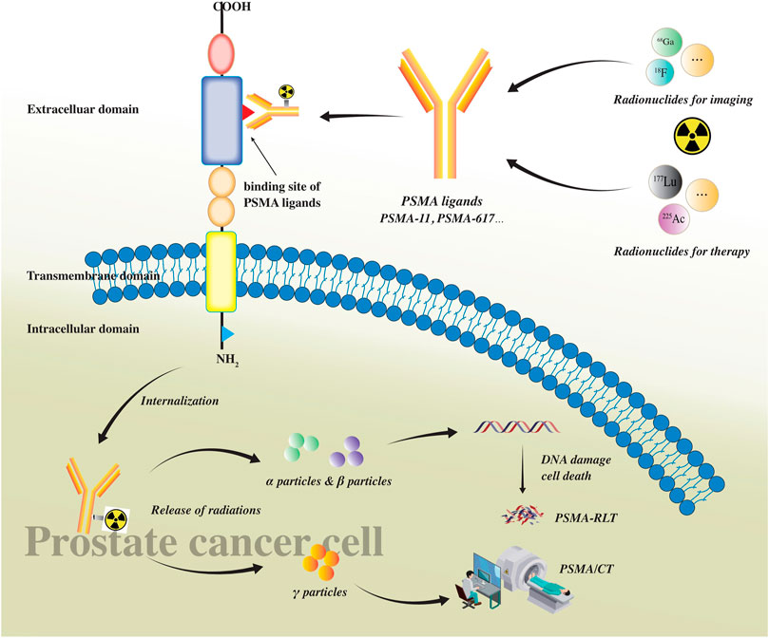
PSMA Mechanism
Prostate cancer cells overexpress PSMA at the cell surface
Normal cells express PSMA mainly within the cell
Chen J, Qi L, Tang Y, Tang G, Gan Y, Cai Y. Current role of prostate-specific membrane antigen-based imaging and radioligand therapy in castration-resistant prostate cancer. Front Cell Dev Biol. 2022 Aug 12;10:958180. doi: 10.3389/fcell.2022.958180. PMID: 36036001; PMCID: PMC9411749.
Notes:
EXPRESSION – Normal cells express PSMA within the cell vs. Cancer cells express it outside the cell @ membrane
Over expressed 1000x higher approx. in cancer cells
DENSITY much higher as well
With PSMA scans, we exploit these differences to get precise imaging
Once it binds, the cell takes it in, then gives off those gamma ray emissions, which show up on the scan (homing signal/GPS tracker)
AUTHOR=Chen Jiaxian, Qi Lin, Tang Yongxiang, Tang Guyu, Gan Yu, Cai Yi
TITLE=Current role of prostate-specific membrane antigen-based imaging and radioligand therapy in castration-resistant prostate cancer
JOURNAL=Frontiers in Cell and Developmental Biology
VOLUME=10
YEAR=2022
URL=https://www.frontiersin.org/articles/10.3389/fcell.2022.958180

Slide 34
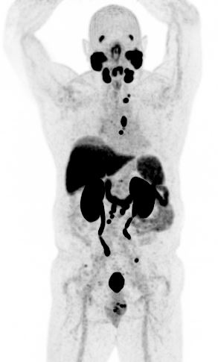
Case Study / Recurrent Prostate Cancer
  CT and bone scan were negative
  PSMA PET/CT to evaluate
  rising PSA
  showed multiple small nodes in the chest and abdomen
  CT guided biopsy confirmed metastatic disease at T7 vertebra
Notes:
FRANK
Examples of tissue & germline impacting patient/family

Slide 35
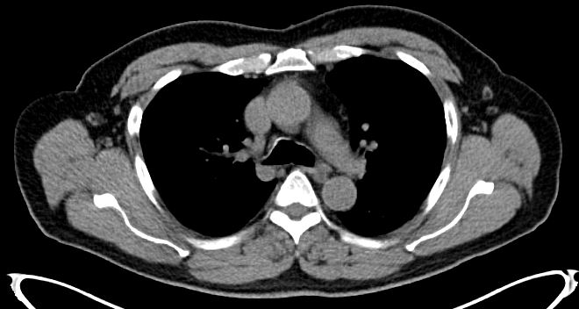
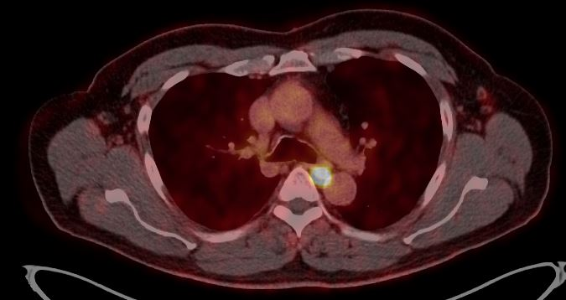
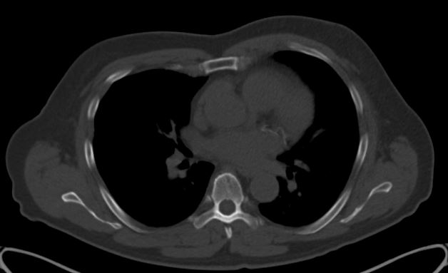
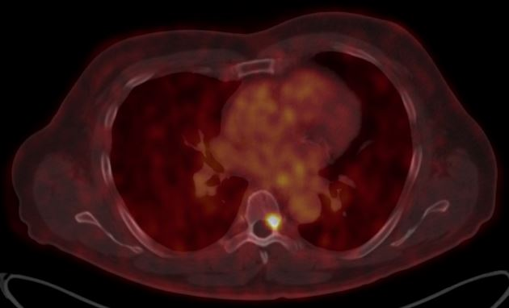
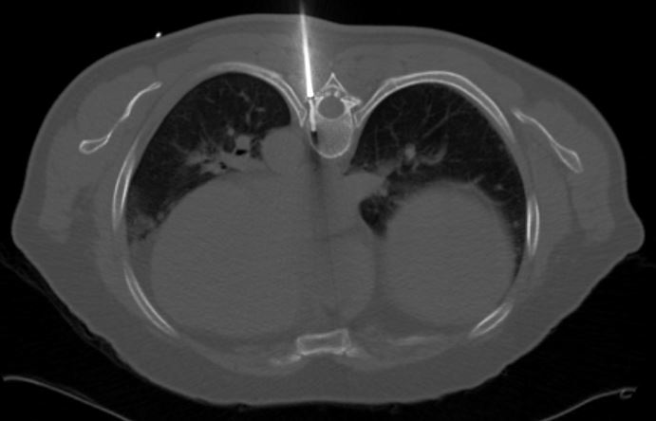

Slide 36
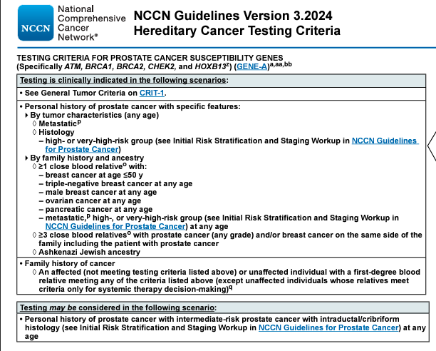
NCCN Germline Testing Criteria:
Personal history PrCA

Slide 37
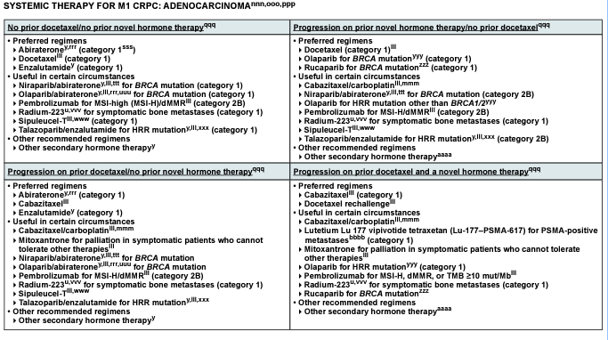
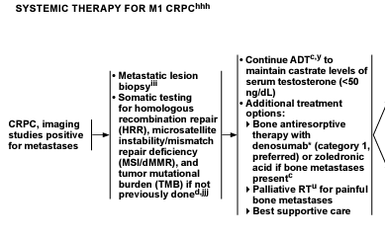
Homologous Recombination Repair gene mutations (HRRm): M1 prostate cancer only
*HRRm: BRCA1, BRCA2, ATM, BARD1, BRIP1, CDK12, CHEK1, CHEK2, FANCL, PALB2, RAD51B, RAD51C, RAD51D, RAD54L

Slide 38
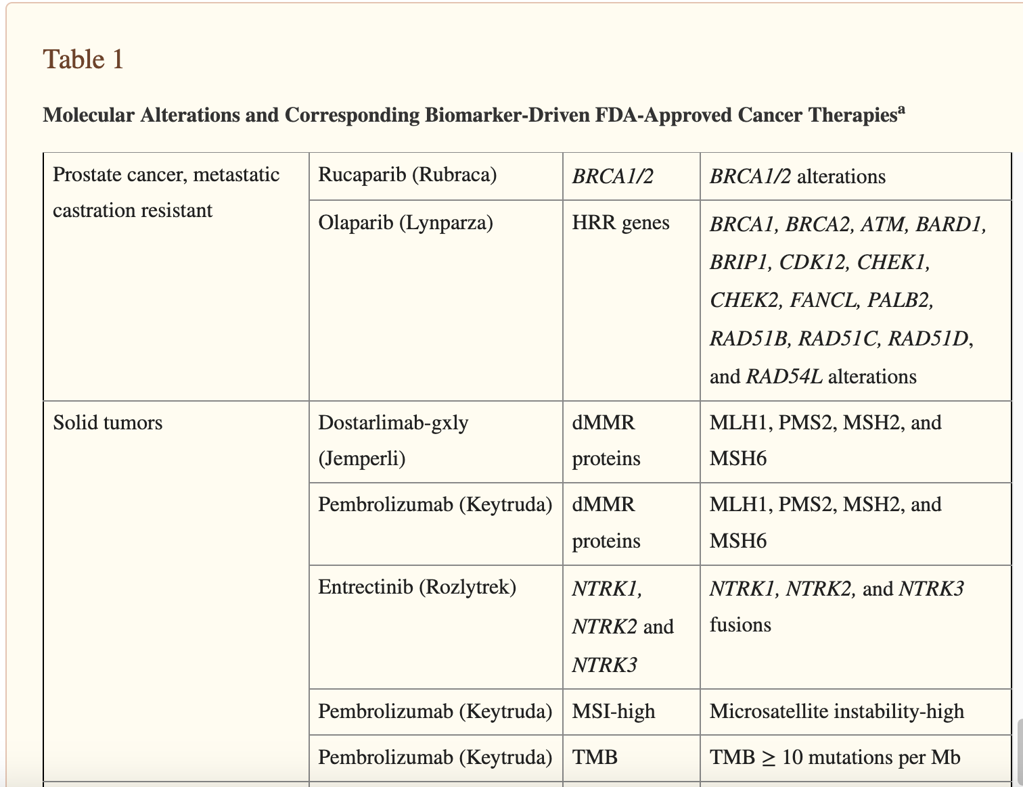
The Role of Biomarkers in Guiding Clinical Decision-Making in Oncology
Prostate cancer specific therapies
  PARP Inhibitors
Pan Tumor therapies
  Immunotherapy
Moore DC, Guinigundo AS
J Adv Pract Oncol. 2023 Apr;14(Suppl 1):15-37
Notes:
Moore DC, Guinigundo AS. The Role of Biomarkers in Guiding Clinical Decision-Making in Oncology. J Adv Pract Oncol. 2023 Apr;14(Suppl 1):15-37. doi: 10.6004/jadpro.2023.14.3.17. Epub 2023 Apr 1. PMID: 37206905; PMCID: PMC10190804.

Slide 39
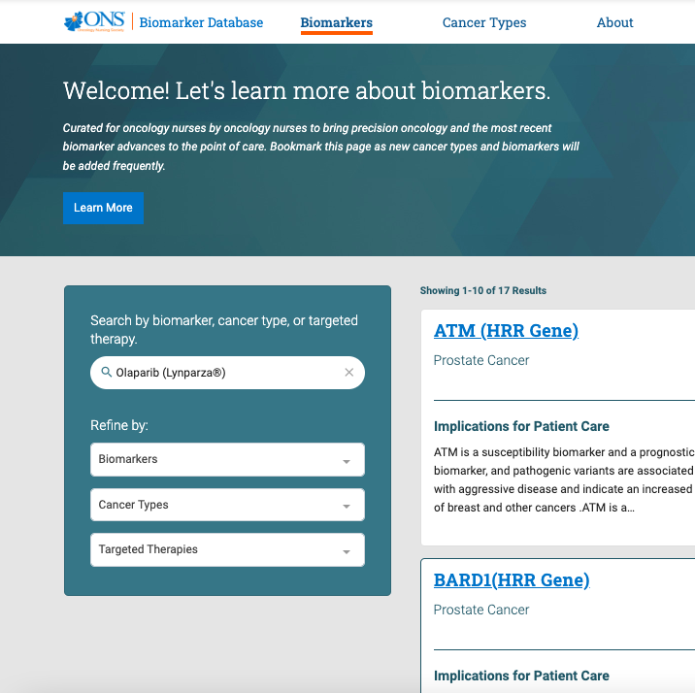
https://biomarkers.ons.org/biomarkers/
https://www.ons.org/learning-libraries/precision-oncology

Slide 40
Case Study 2 / Recurrent Prostate Cancer, Mr. H.
  Germline testing revealed at BRCA2 mutation
  Started ADT, given Castrate-Sensitive M1 disease
  If disease becomes Castrate-resistant in the future, may consider targeted therapies, including PARP Inhibitors

Slide 41
Prostate Cancer Precision Medicine Summary
Patients with low- to intermediate-risk prostate cancer can consider somatic tissue genomic testing, to aid in treatment decision-making
Men with intermediate- and higher-risk disease may consider germline genetic testing, if they have other factors, such as:
Advanced/metastatic disease
Family history of specific cancers
A known mutation in the family
Use of PARP inhibitors for men with advanced disease, who also carry a specific germline gene mutation (HR deficiency)
Possible access to immunotherapies, related to tissue biomarker testing
Notes:
FRANK

Slide 42

Multidisciplinary Strategies for Optimizing Biomarker Testing in mCRC
Oncologists can:
Communicate to pathologists why they are ordering specific tests; prioritize biomarker tests ordered
Discuss optimal biopsy specimen collection with surgical oncologists and interventionalists to ensure adequate tissue for planned tests
Pathologists can:
Provide guidance on test selection
Ensure that samples contain adequate tumor tissue and are processed appropriately
Provide assistance with test interpretation
Minimize turnaround time by ensuring that archived tissue can be retrieved quickly and efficiently
Advanced practitioners and/or genetic counselors can:
Flag results that suggest a hereditary syndrome; order germline testing
Communicate with and educate patients; assist patients and families with cascade testing
All groups can:
Participate in molecular tumor boards or other multidisciplinary case discussions as available
Stay ahead of the curve as new biomarkers enter standard of care and make a plan for including them in routine practice
Schmid S, et al. ESMO Open. 2022;7(5):100570.
Notes:
dela Rama

Slide 43
Defining a Supportive Role: Navigating Precision Medicine
Nurse and patient navigators can facilitate biomarker testing by:
Ordering germline and somatic testing
Obtaining referrals to cancer genetics professionals
Specialized roles/job descriptions have developed to fit these needs:
Precision medicine navigators, genetic extenders, precision medicine stewards, etc.
Point person who coordinates all aspects of send-out biomarker tests to move them forward and obtain results in a timely fashion
Works closely with medical oncology, laboratory operations, testing vendors, and genetic counseling
Educates patients on need for testing and type of testing (eg blood draw)
Assists patients with financial aspects of testing: insurance, out-of-pocket costs, and financial assistance forms
Participates in process improvement initiatives/vendor evaluation
Important to consider scope of this newly created position
Association of Community Cancer Centers. Accessed 1/17/23 at https://www.accc-cancer.org/docs/documents/oncology-issues/articles/2022/v37-n6/v37-n6-precision-medicine-stewards-a-case-study-from-sanford-health.pdf
Notes:
Dela Rama
Khan has next test question

Slide 44
Bringing precision medicine to the “bedside”
Nurses have unique opportunities to affect patients & families, with knowledge of genetics/genomics
Genetics (and all “-omics) = crucial across the health care continuum
Interventions can be simple, directly with patients or within the healthcare team
Valuable roles as educator & advocate with patients

Slide 45
Web Resources
ONS: Genomics and Precision Oncology Learning Library
  https://www.ons.org/learning-libraries/precision-oncology
AONN: Precision Medicine Toolkit
  https://aonnonline.org/toolkits
Cancer Support Community: Frankly Speaking
  https://www.cancersupportcommunity.org/precision-medicine
National Society of Genetic Counselors
  https://www.nsgc.org/page/find-a-genetic-counselor
International Society of Nurses in Genetics (ISONG)
  https://www.isong.org/

Slide 46
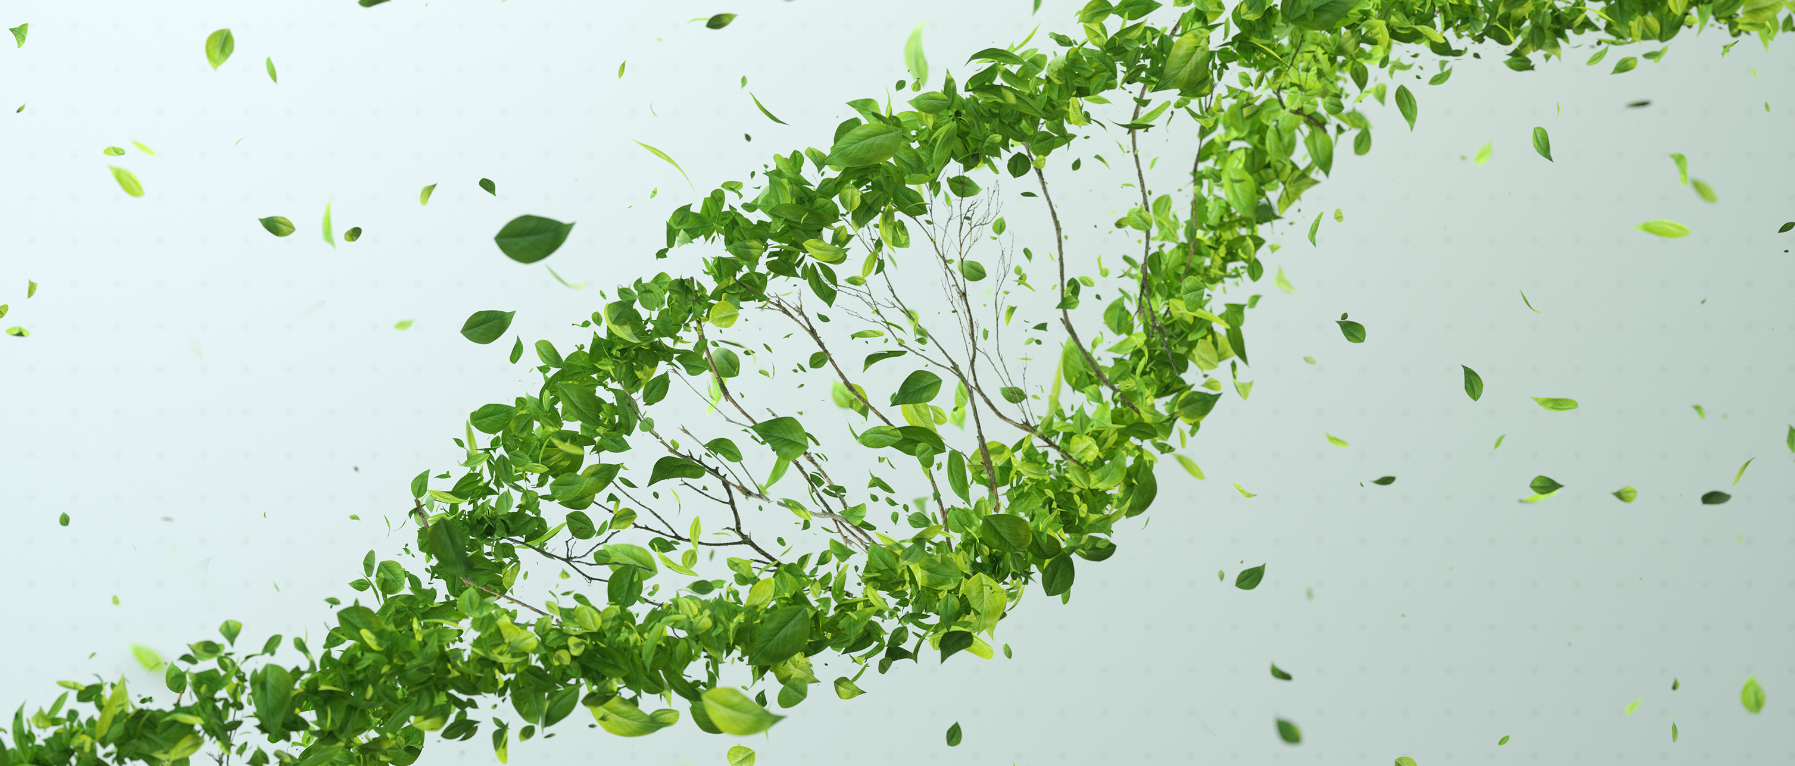
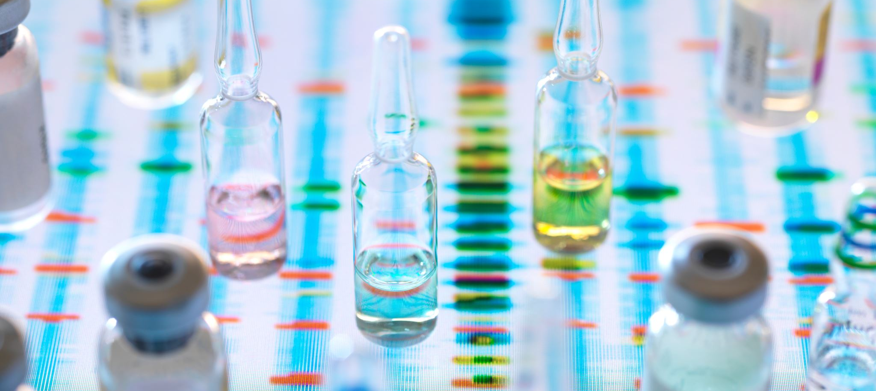
Thank you for your time
Questions?
Frank.delarama@sutterhealth.org
Frank@Navvisa.com

Slide 47
Supplemental Slides / Resources

Slide 48
Additional Web Resources
NCCN Guidelines
  Genetic/Familial High-Risk Assessment: Breast and Ovarian
  Genetic/Familial High-Risk Assessment: Colorectal
  https://www.nccn.org/professionals/physician_gls/default.aspx#detection
Cancer.Net (ASCO) - patient education
  https://www.cancer.net/navigating-cancer-care/cancer-basics/genetics

Slide 49
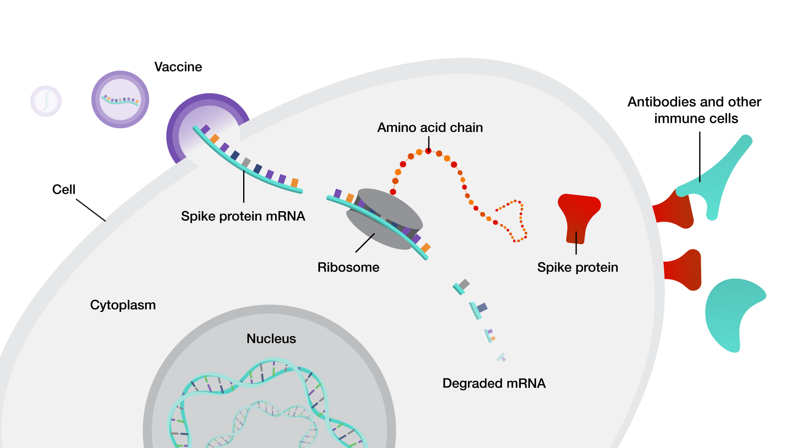
How does an mRNA vaccine work?
Notes:
Genome.gov
https://www.genome.gov/about-genomics/fact-sheets/Understanding-COVID-19-mRNA-Vaccines
How does an mRNA vaccine work?
mRNA acts as a cellular messenger. DNA, which is stored in a cell’s nucleus, encodes the genetic information for making proteins. mRNA transfers a copy of this genetic information outside of the nucleus, to a cell’s cytoplasm, where it is translated into amino acids by ribosomes and then folded into complete proteins. mRNA is a short-lived molecule, meaning it degrades easily and does not last long inside cells.
By injecting cells with a synthetic mRNA that encodes a viral spike protein, an mRNA vaccine can direct human cells to make a viral spike protein and evoke an immune response without a person ever having been exposed to the viral material.
These viral spike proteins, or antigens, normally coat the surface of the virus and are recognized by antibodies and other immune cells that prepare and protect the body against the virus. If a person is later exposed to the virus, antibodies and other parts of the immune system can recognize and attack the virus before it can infect healthy cells or cause illness.

Slide 50
PARP and Mechanisms of DNA Repair
Environmental factors
(UV, radiation, chemicals)
Normal physiology
(DNA replication)
Chemotherapy
(alkylating agents, antimetabolites)
Radiotherapy
DNA DAMAGE
Cell Death
Replication Lesions
Base excision repair
  PARP1
MAJOR DNA REPAIR
PATHWAYS
Single Strand Breaks
Nucleotide excision repair
Base excision repair
  PARP1
DNA Adducts/Base Damage
Alkyltransferases
Nucleotide excision repair
Base excision repair
  PARP1
Double Strand Breaks
Nonhomologous end-joining
Homologous recombination
  BRCA1/BRCA2
Fanconi anemia pathway
Endonuclease-mediated repair
Helleday. Nat Rev Cancer. 2008;8:193.
Notes:
Why is DNA repair important in cancer?
With some cancer treatments, we aim to inflict DNA damage to the cancer cells, but at the same time, avoiding damage to the normal cells
Cancer cells are good at dividing quickly (although irregularly), but thankfully, they are not very good about repairing themselves
Basic biology of cancer treatment
LEFT CORNER:
What causes DNA damage?
Envir = associated with sporadic / random / general population risk
Normal phys = again random – DNA replication is a complex process / a lot of moving parts – probably amazing that we don’t have more cancers (human body is amazing…)
Chemo & Radiation: cancer treatments --- inflicting controlled damage
SS breaks: PARP1 is the “mechanic on call”
DS breaks: BRCA1/2 (other HRR genes)
Replication lesions: PARP1 again
- DNA lesion refers to a section of a DNA molecule containing a primary damaged site i.e. a base alteration, a base deletion, a sugar alteration or a strand break. Replication before repair, or inefficient repair, can result in the fixation of a primary lesion as a permanent mutation.
DNA Adducts / Base Damage: PARP1 again
In molecular genetics, a DNA adduct is a segment of DNA bound to a cancer-causing chemical. This process could lead to the development of cancerous cells, or carcinogenesis. DNA adducts in scientific experiments are used as biomarkers of exposure.
Chemicals that form DNA adducts[edit]
Figure 3: DNA damaged by carcinogenic 2-aminofluorene
acetaldehyde, a significant constituent of tobacco smoke
cisplatin, which binds to DNA and causes crosslinking (leading to cell death)
DMBA (7,12-dimethylbenz(a)anthracene)
malondialdehyde, a naturally-occurring product of lipid peroxidation
polycyclic aromatic hydrocarbons (PAHs)^{[7]}
nitro-PAHs^{[8]}
Nitrosamines^{[9]}
Aflatoxins^{[10]}
Mustards^{[11]}
aromatic amines^{[12]}
heterocyclic aromatic amines (HAAs)^{[13]}
methylating agents^{[14]}
other alkylating agents^{[15]}
Haloalkanes^{[16]}
NCI definition: PARP -- A type of enzyme involved in many functions of the cell, including the repair of DNA damage. DNA damage may be caused by normal cell actions, UV light, some anticancer drugs, and radiation used to treat cancer. Inhibitors of one enzyme, PARP-1, are being studied in the treatment of cancer. Also called poly (ADP-ribose) polymerase.
DNA repair pathways as targets for cancer therapy (Thomas Helleday, et al.)
- Cancer therapy usually involves exposing the body to
agents that kill cancer cells more efficiently than normal
tissue cells. Such therapies must therefore exploit specific
molecular and cellular features of the cancer they are aiming
to eliminate. Most cancer cells proliferate more rapidly
than their normal counterparts so most cancer drugs
target the cell cycle.
-However, the most common means of targeting the cell cycle is to exploit the effect of DNA-damaging drugs. DNA damage
causes cell-cycle arrest and cell death either directly or following DNA replication during the S phase of the cell cycle. Cellular attempts to replicate damaged DNA can
cause increased cell killing, thus making DNA-damaging treatments more toxic to replicating cells than to nonreplicating
cells.
- The toxicity of DNA-damaging drugs can be reduced by the activities of several DNA
repair pathways that remove lesions before they become toxic. The efficacy of DNA damage-based cancer therapy
can thus be modulated by DNA repair pathways.
In addition, some of these pathways are inactivated in some cancer
types. These two features make DNA repair mechanisms a promising target for novel cancer treatments.
Several cancer chemotherapy drugs work by producing excessive DNA damage that
causes cell death directly or following DNA replication. Survival is promoted through
repair of these lesions by a number of DNA repair pathways.
• The efficacy of anticancer drugs is highly influenced by cellular DNA repair capacity.
Inhibitors of DNA repair increase the efficacy of DNA-damaging anticancer drugs

Slide 51
Genetic Testing in Prostate Cancer
ALL men with mPC should receive genetic testing and genetic counseling, regardless of family history
BRCA1 or BRCA2 and other DDR germline mutations associated with increased risk of prostate cancer
11.8% of men with mPC have germline DNA-repair gene mutations regardless of family history
Somatic mutations in DNA repair pathways in 19% of localized and 23% of mCRPC tumors
Do ask about family and personal history at prostate cancer diagnosis
If tumor mutations in BRCA1/BRCA2, ATM, PALB2, CHEK2, MLH1, MSH2, MSH6, or PMS2 are identified,
refer patient and family for genetic counseling and follow-up testing
Notes:
Germline testing in prostate cancer (usually thought of with breast/ovarian historically) is now widely available, and all mPRCA patients qualify per national guidelines
We know that BRCA1/2 and othe DNA Damage Repair (DDR) genes are associated with prostate ca risk
Family history not needed to consider in mPRCA (localized Prca = should be discussed)
Somatic tissue mutations are fairly common in mPRCA, and also may have an associated germline mutation
Genetic counseling (CGC, AGN-BC, NP/MD) is key here, esp prior to germline testing

Slide 52
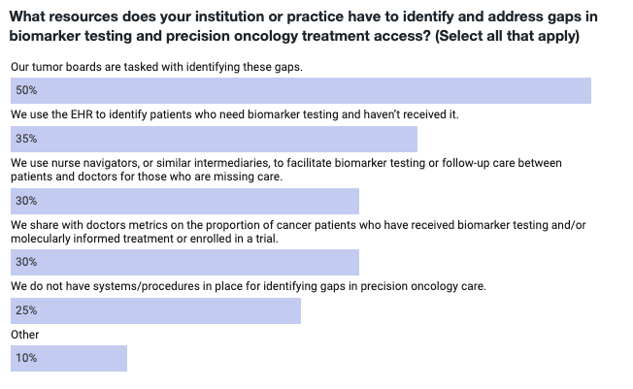
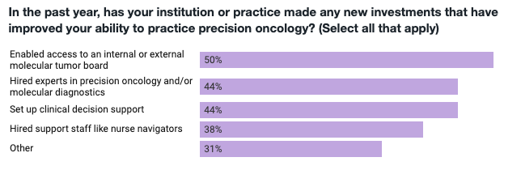
https://www.precisionmedicineonline.com/precision-oncology/precision-oncology-survey-reveals-barriers-cutting-edge-cancer-treatments

